Slide 1


Enhancing Student Success in Kansas:
A Case Study of USD 329-Wabaunsee
April 24, 2024
Troy Pitsch, PhD, Superintendent of Schools-USD 329
Presenters: Sarah Eckstein, LSCSW Mental Health Liaison and Social worker
Jordan Dunn, MS, Elementary and Jr High School Counselor

Slide 2
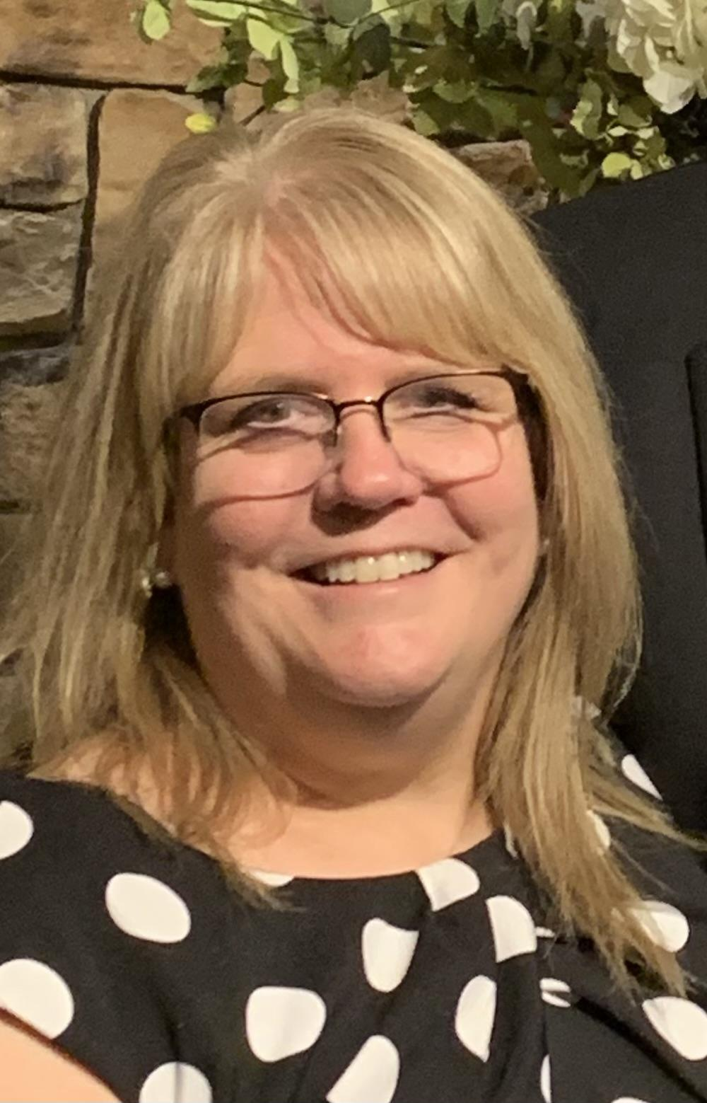
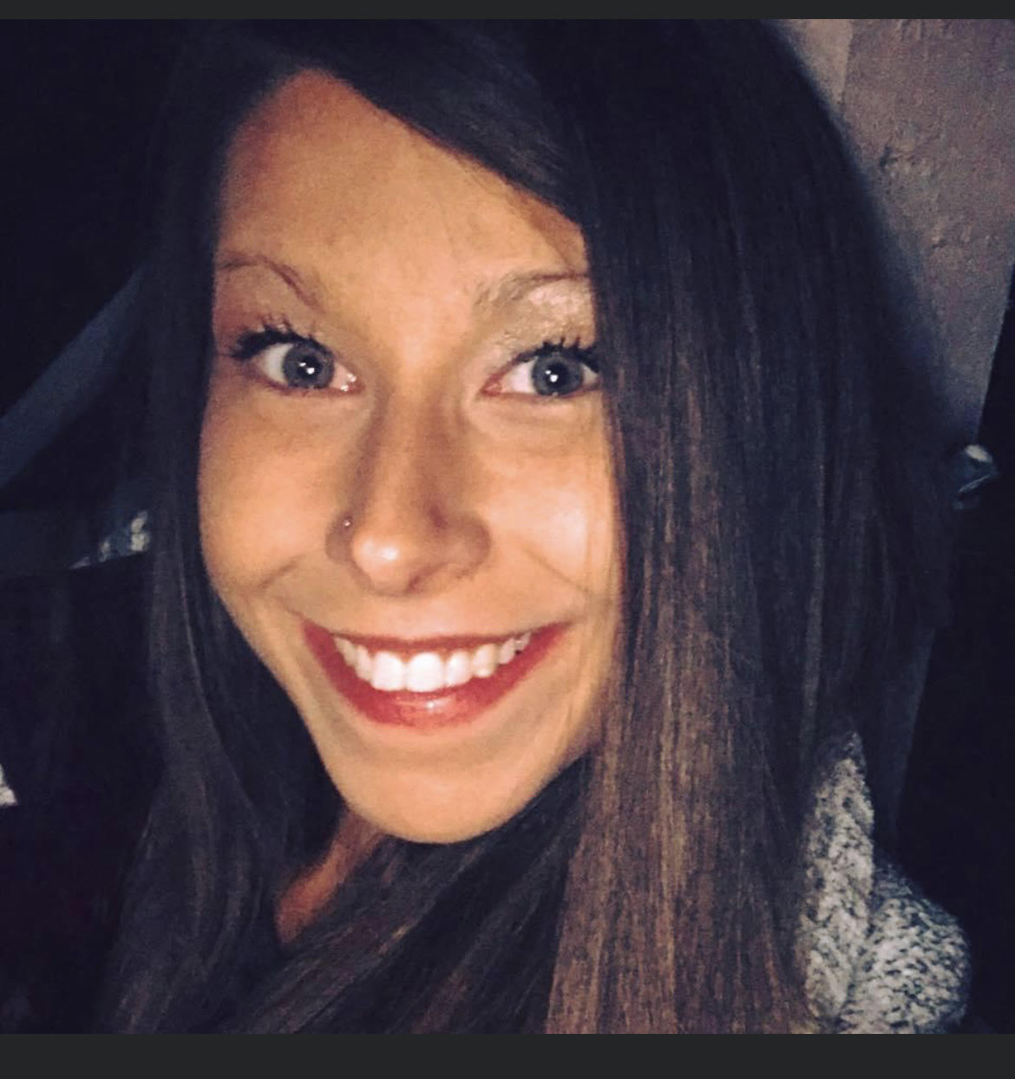
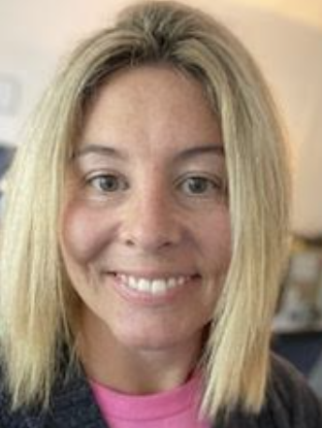
Meet Our Dedicated Team
Sarah Eckstein: Mental Health Liaison & Social Worker
Contributions - TLIM Co-Facilitator
Susan Gronquist: 1st grade teacher
Contributions - TLIM Lighthouse Team Member
Jordan Dunn: PreK - 8th School Counselor
Contributions - TLIM Program Coordinator for USD 329
Callie Meinhardt: 9th - 12th Counselor
Contributions - TLIM High School Integration Specialist

Slide 3
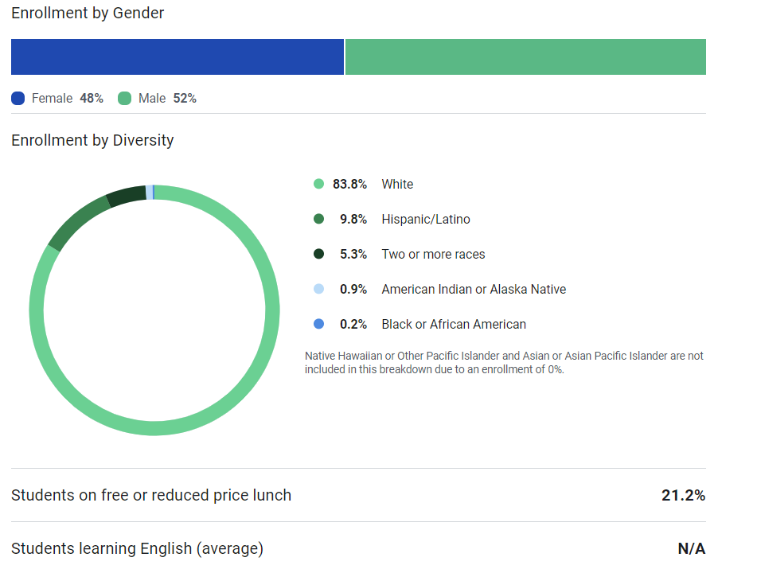
Enrollment Demographics
Notes:
Sarah

Slide 4
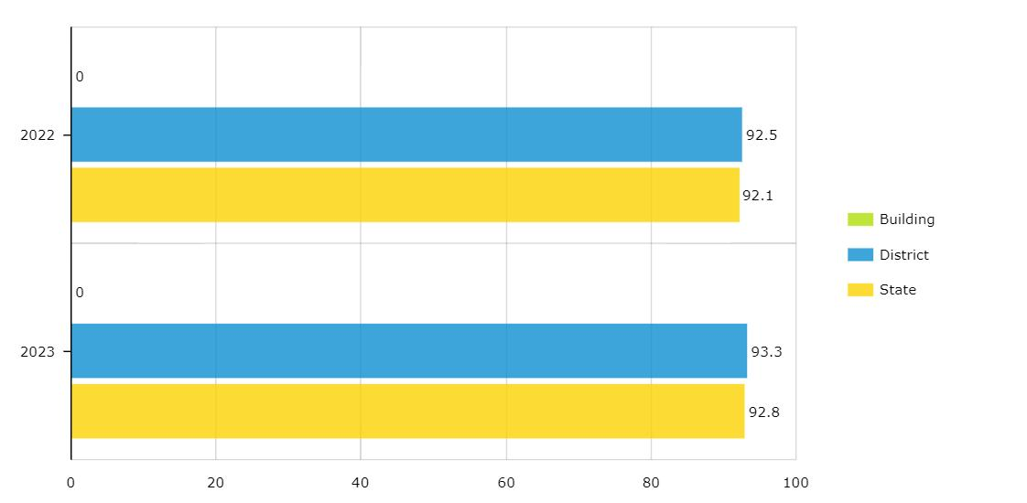
USD 329 Attendance Rate 2022-23
Notes:
Sarah

Slide 5
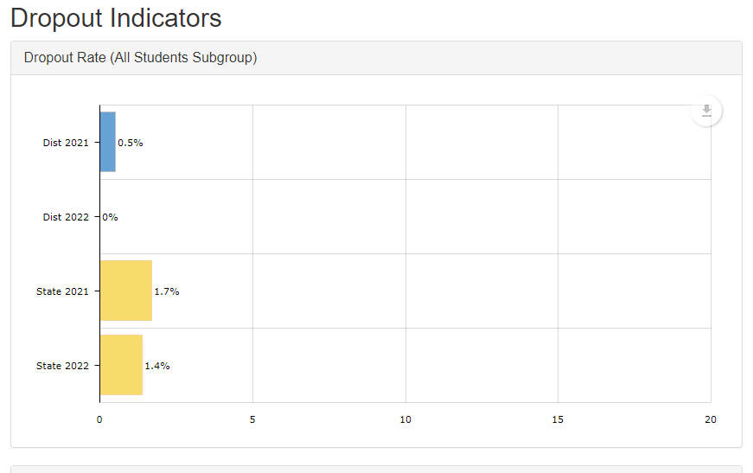
Notes:
Sarah

Slide 6
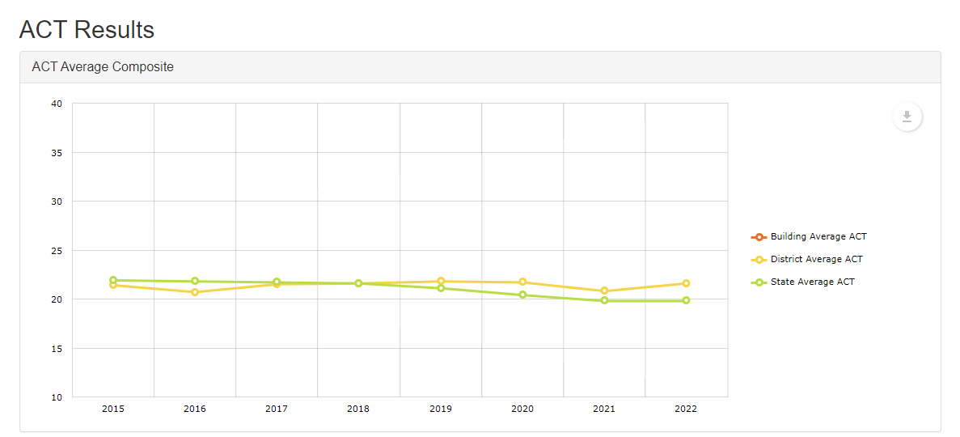
Notes:
Sarah

Slide 7
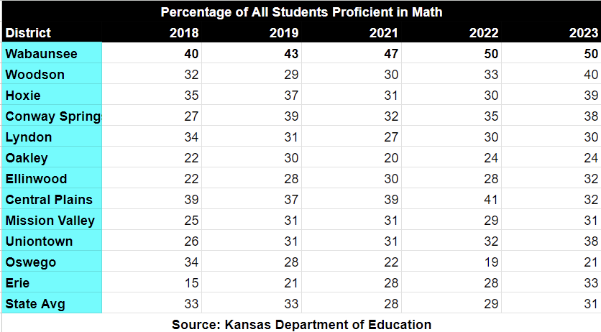
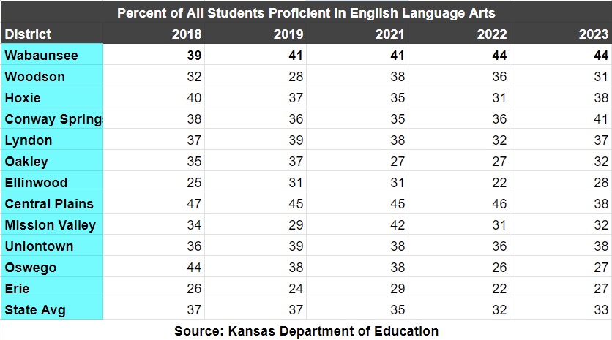
KAP Student Performance Outcomes 2018-2023
30
Notes:
Sarah

Slide 8
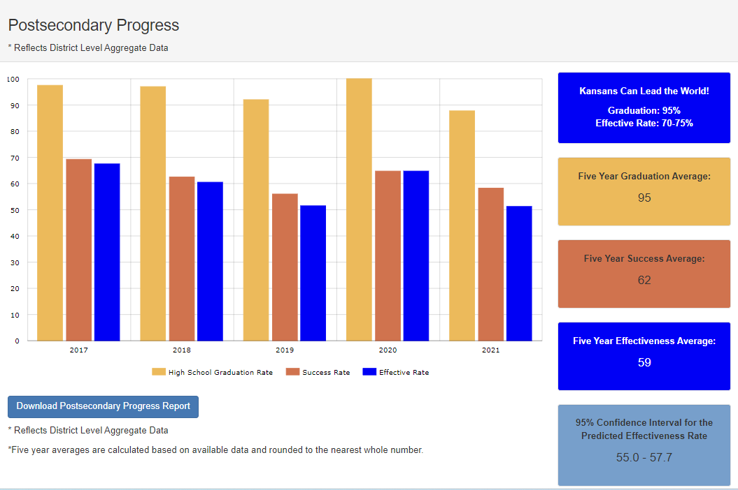
Post-Secondary Progress

Slide 9
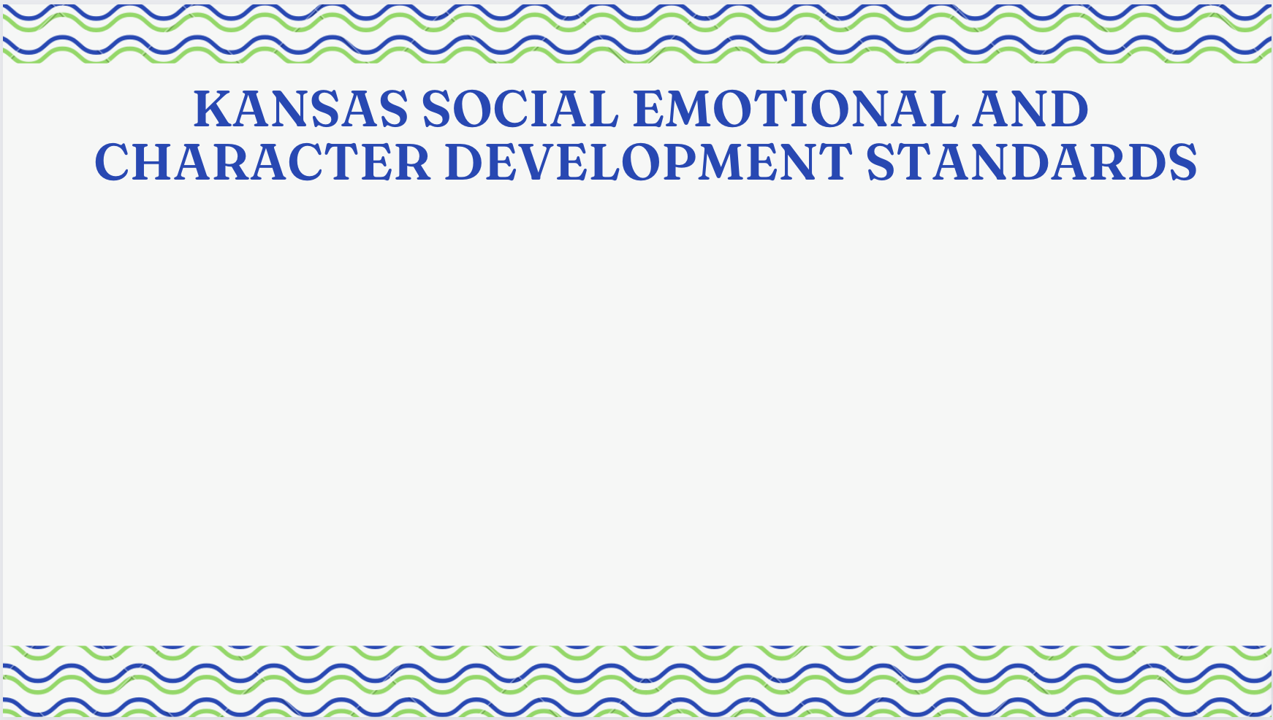
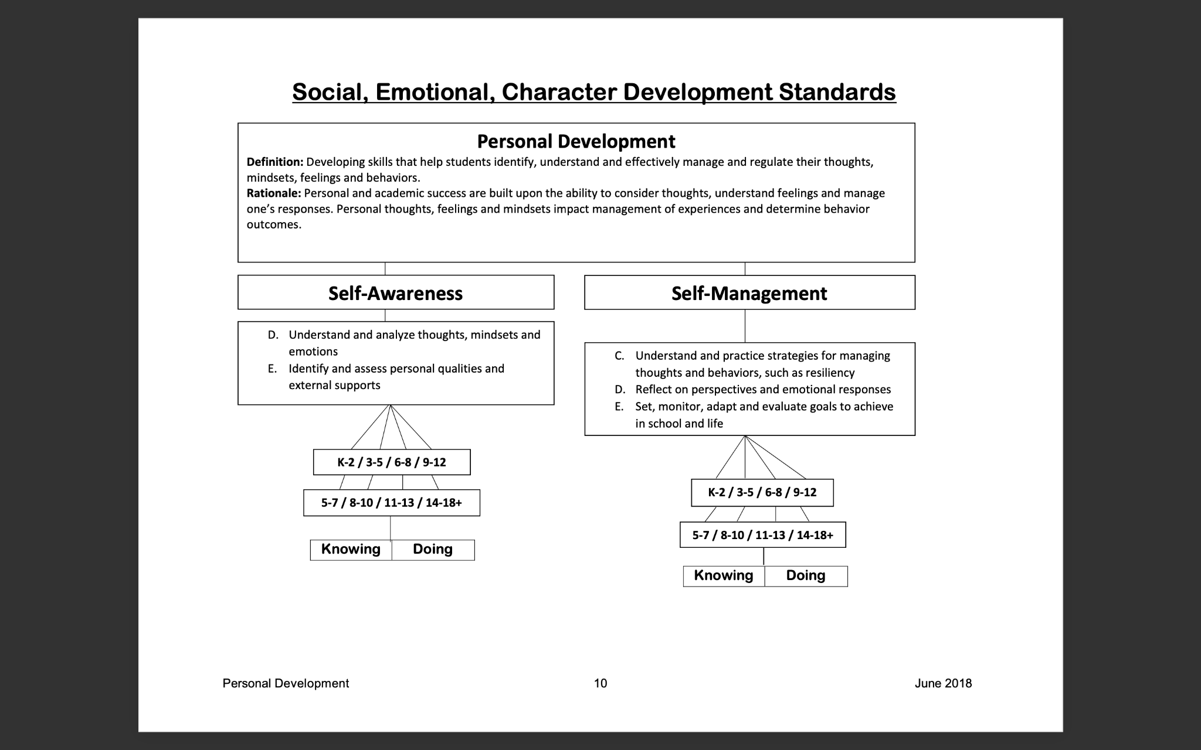
Notes:
Before we jump into how our district utilizes Leader in Me in the classroom here are the Kansas Social Emotional and Character Development Standards. We wanted to bring them to your awareness as you listen to our presentation. You will see how these standards are reflected and illustrated throughout our district’s social-emotional activities.

Slide 10

Notes:
Jordan

Slide 11
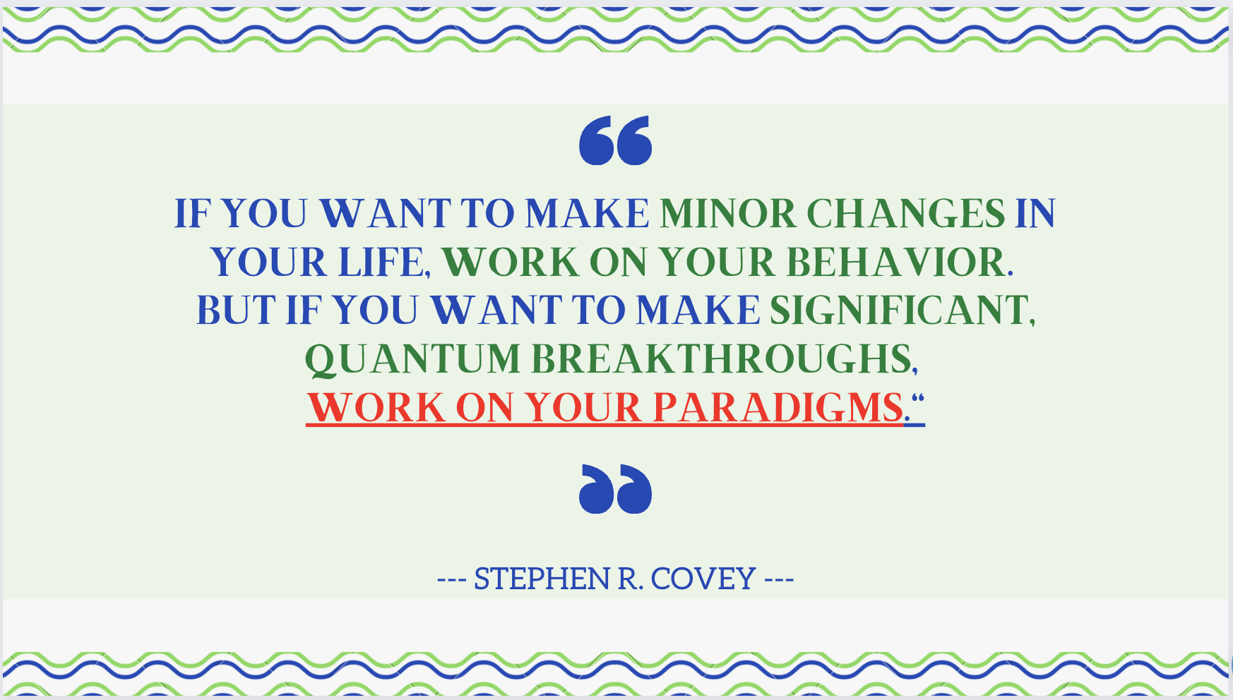
Notes:
Jordan

Slide 12
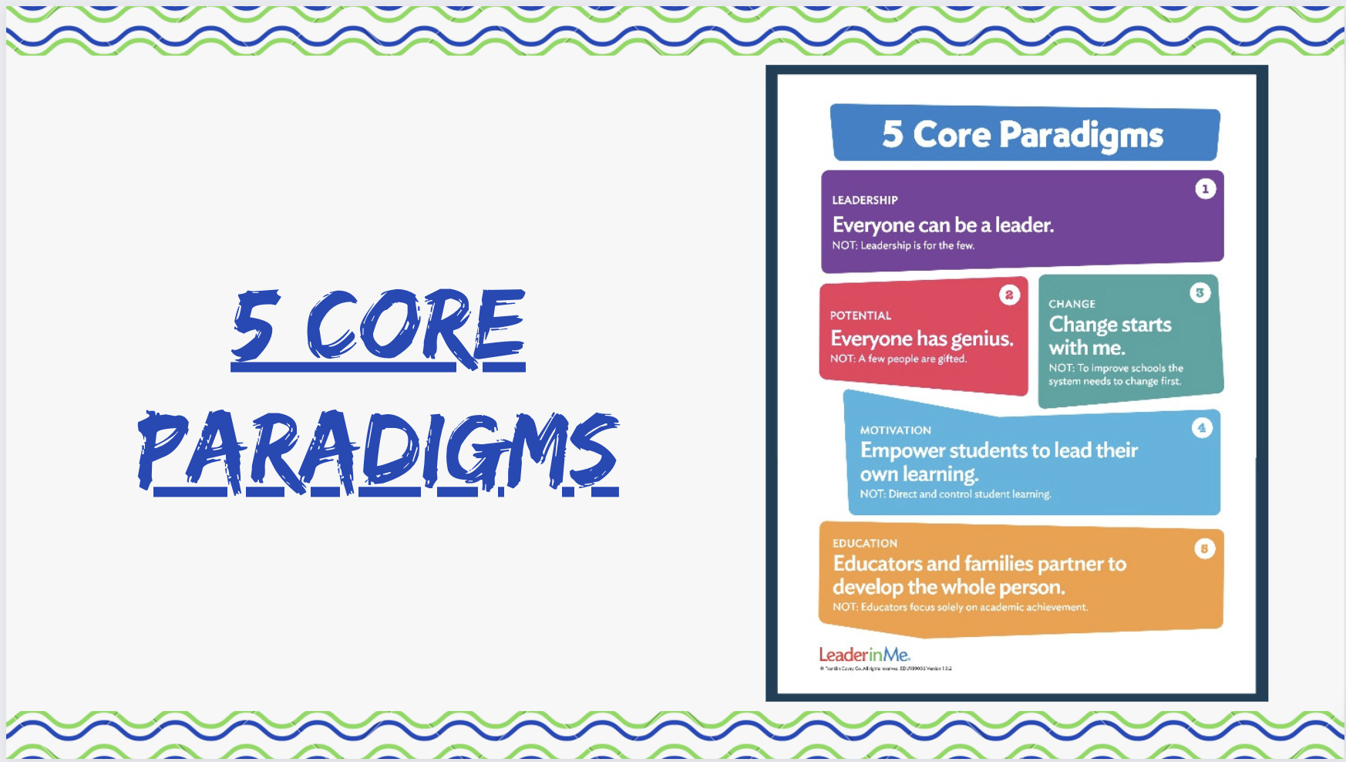
Notes:
Jordan

Slide 13
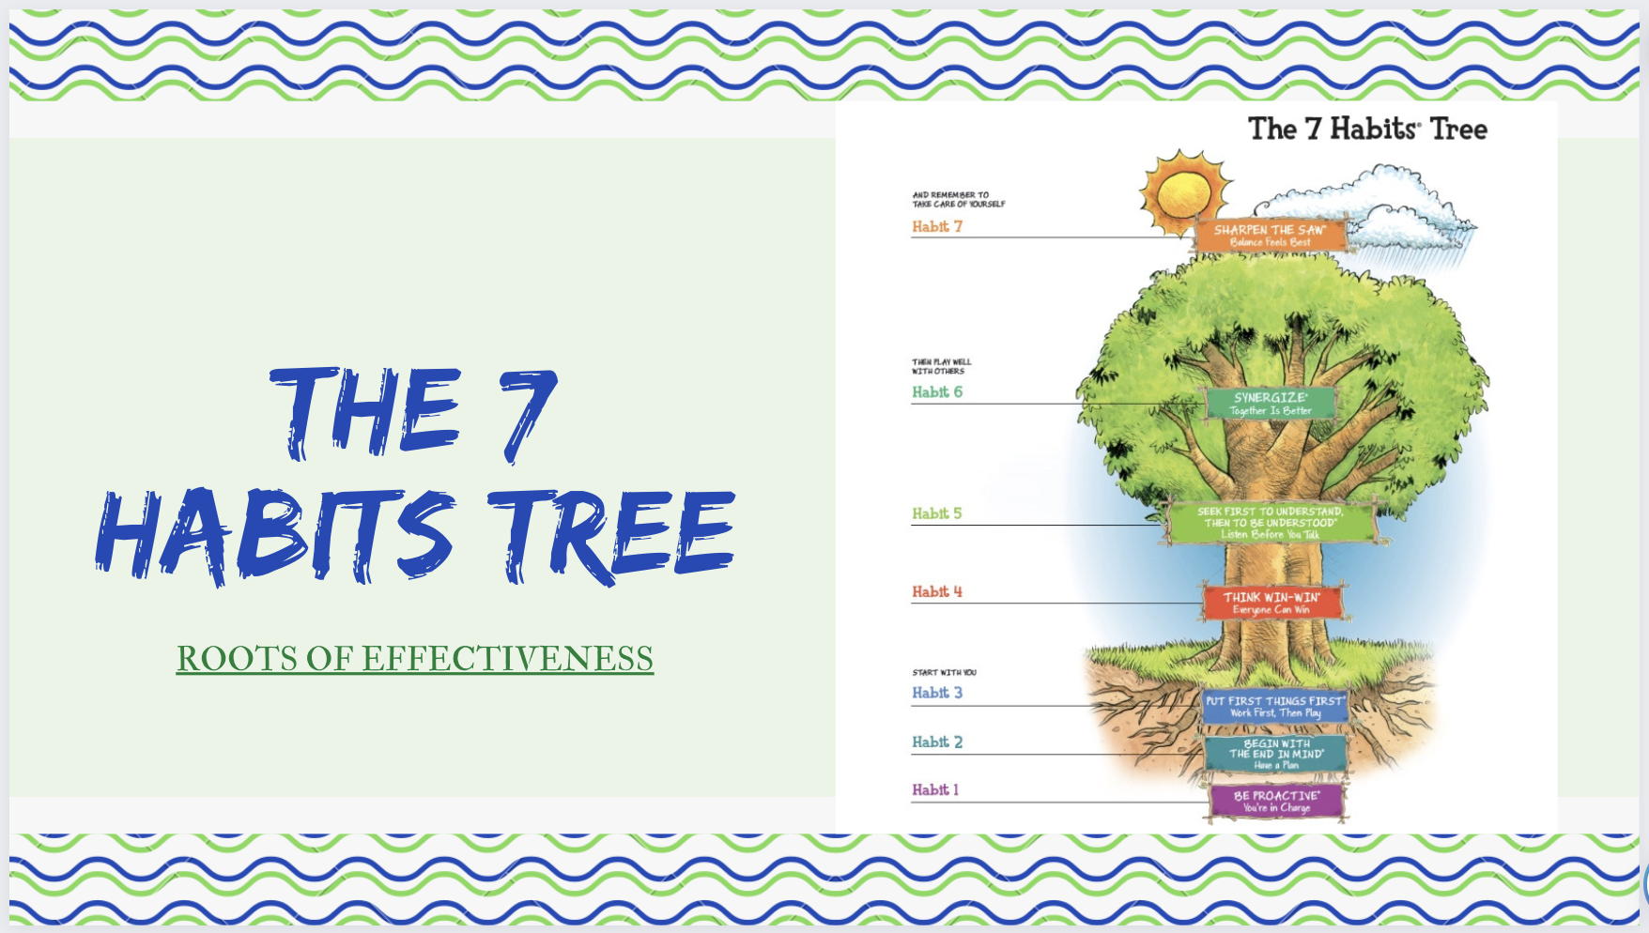
Notes:
Jordan

Slide 14
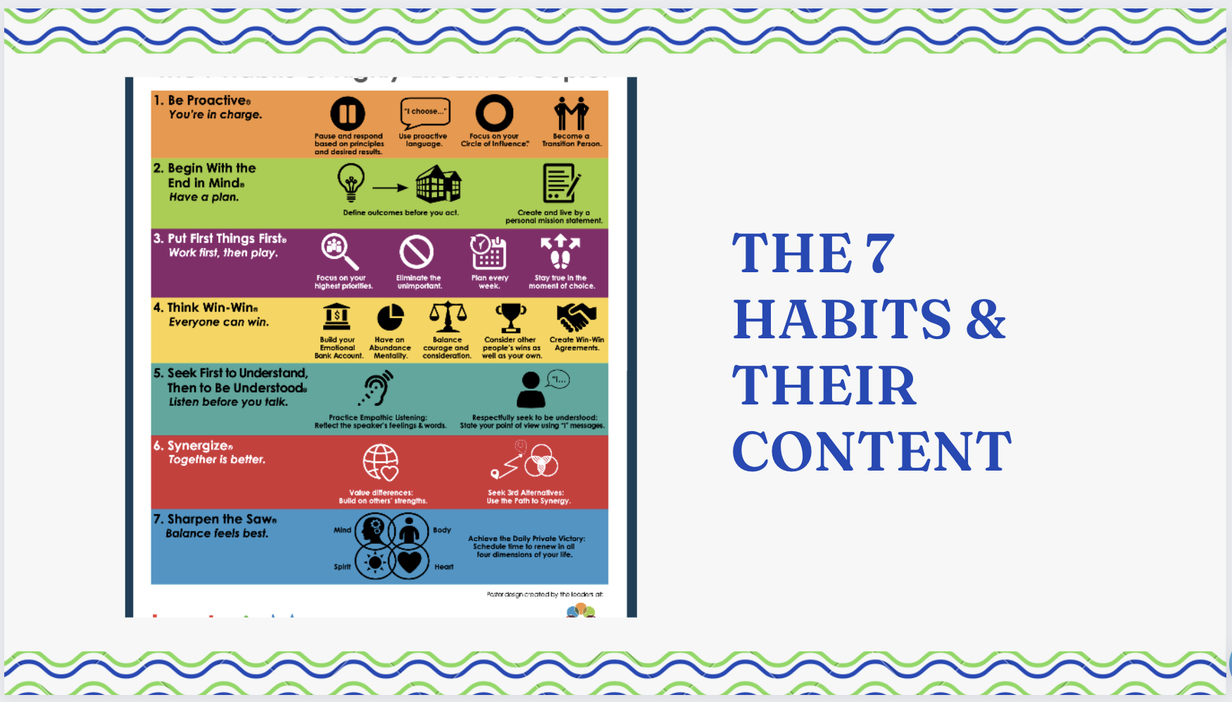
Notes:
Jordan

Slide 15
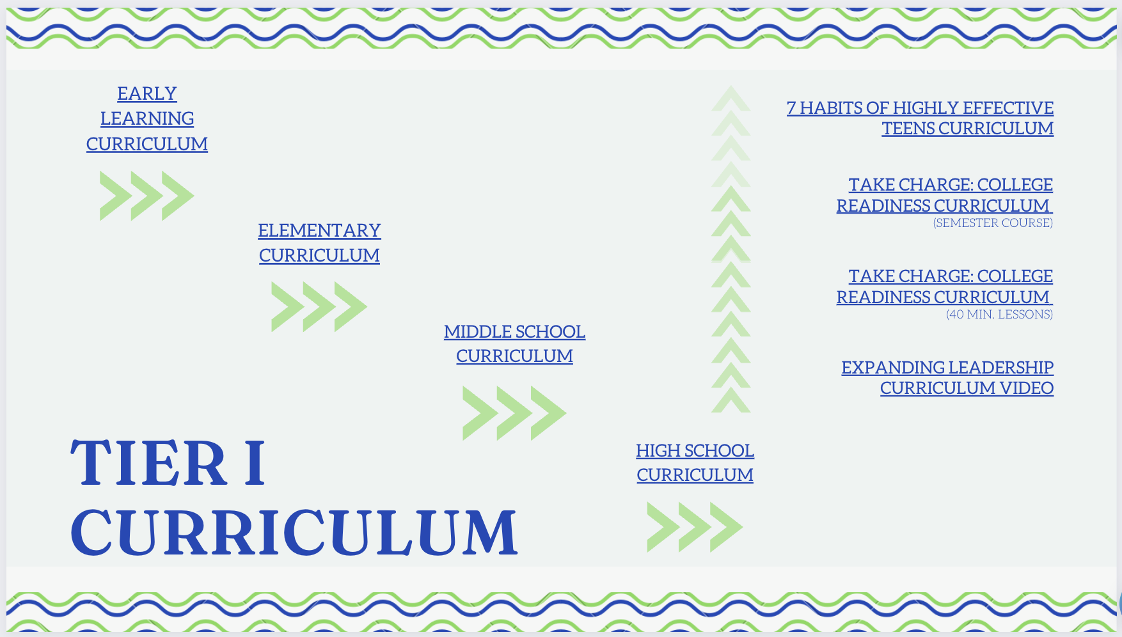
Notes:
Jordan

Slide 16
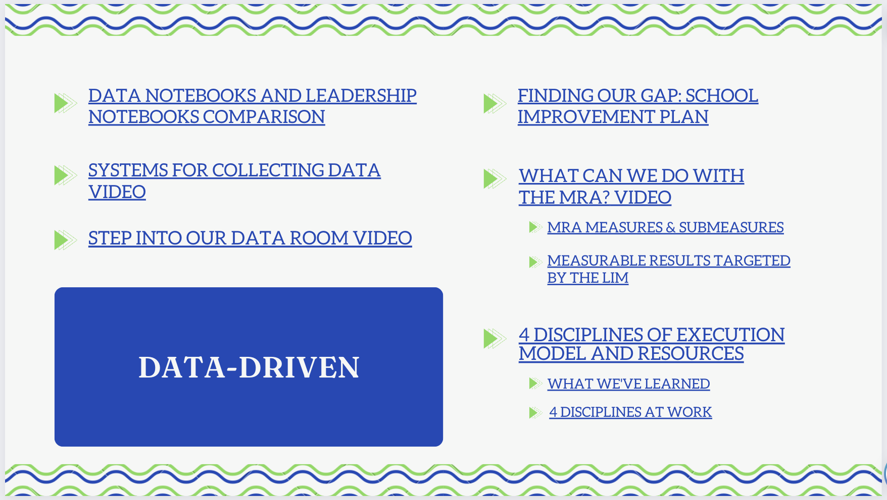
Notes:
Jordan

Slide 17
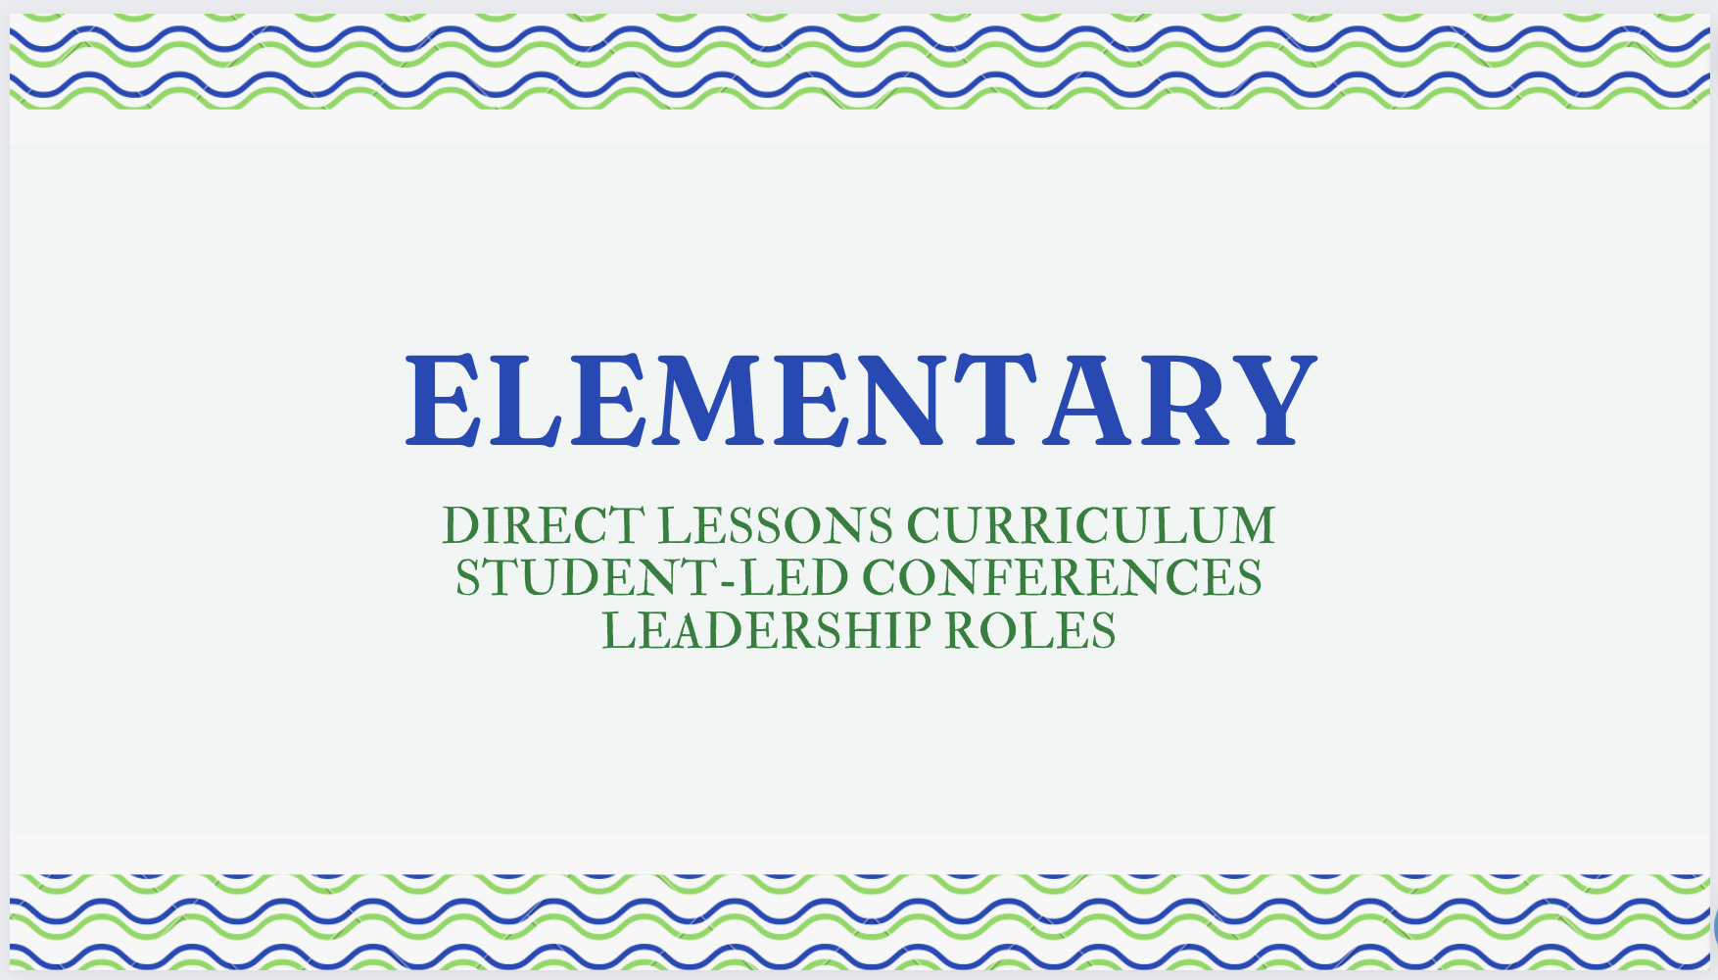

Slide 18
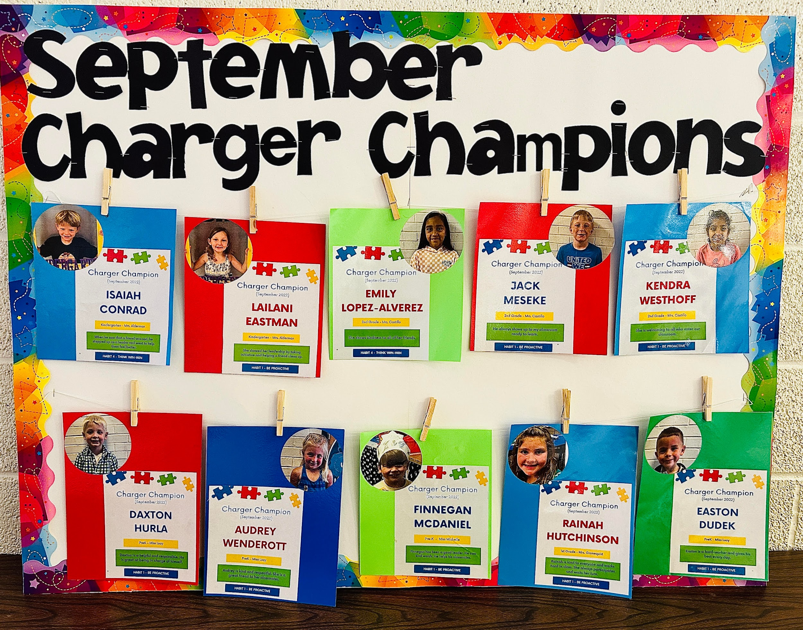
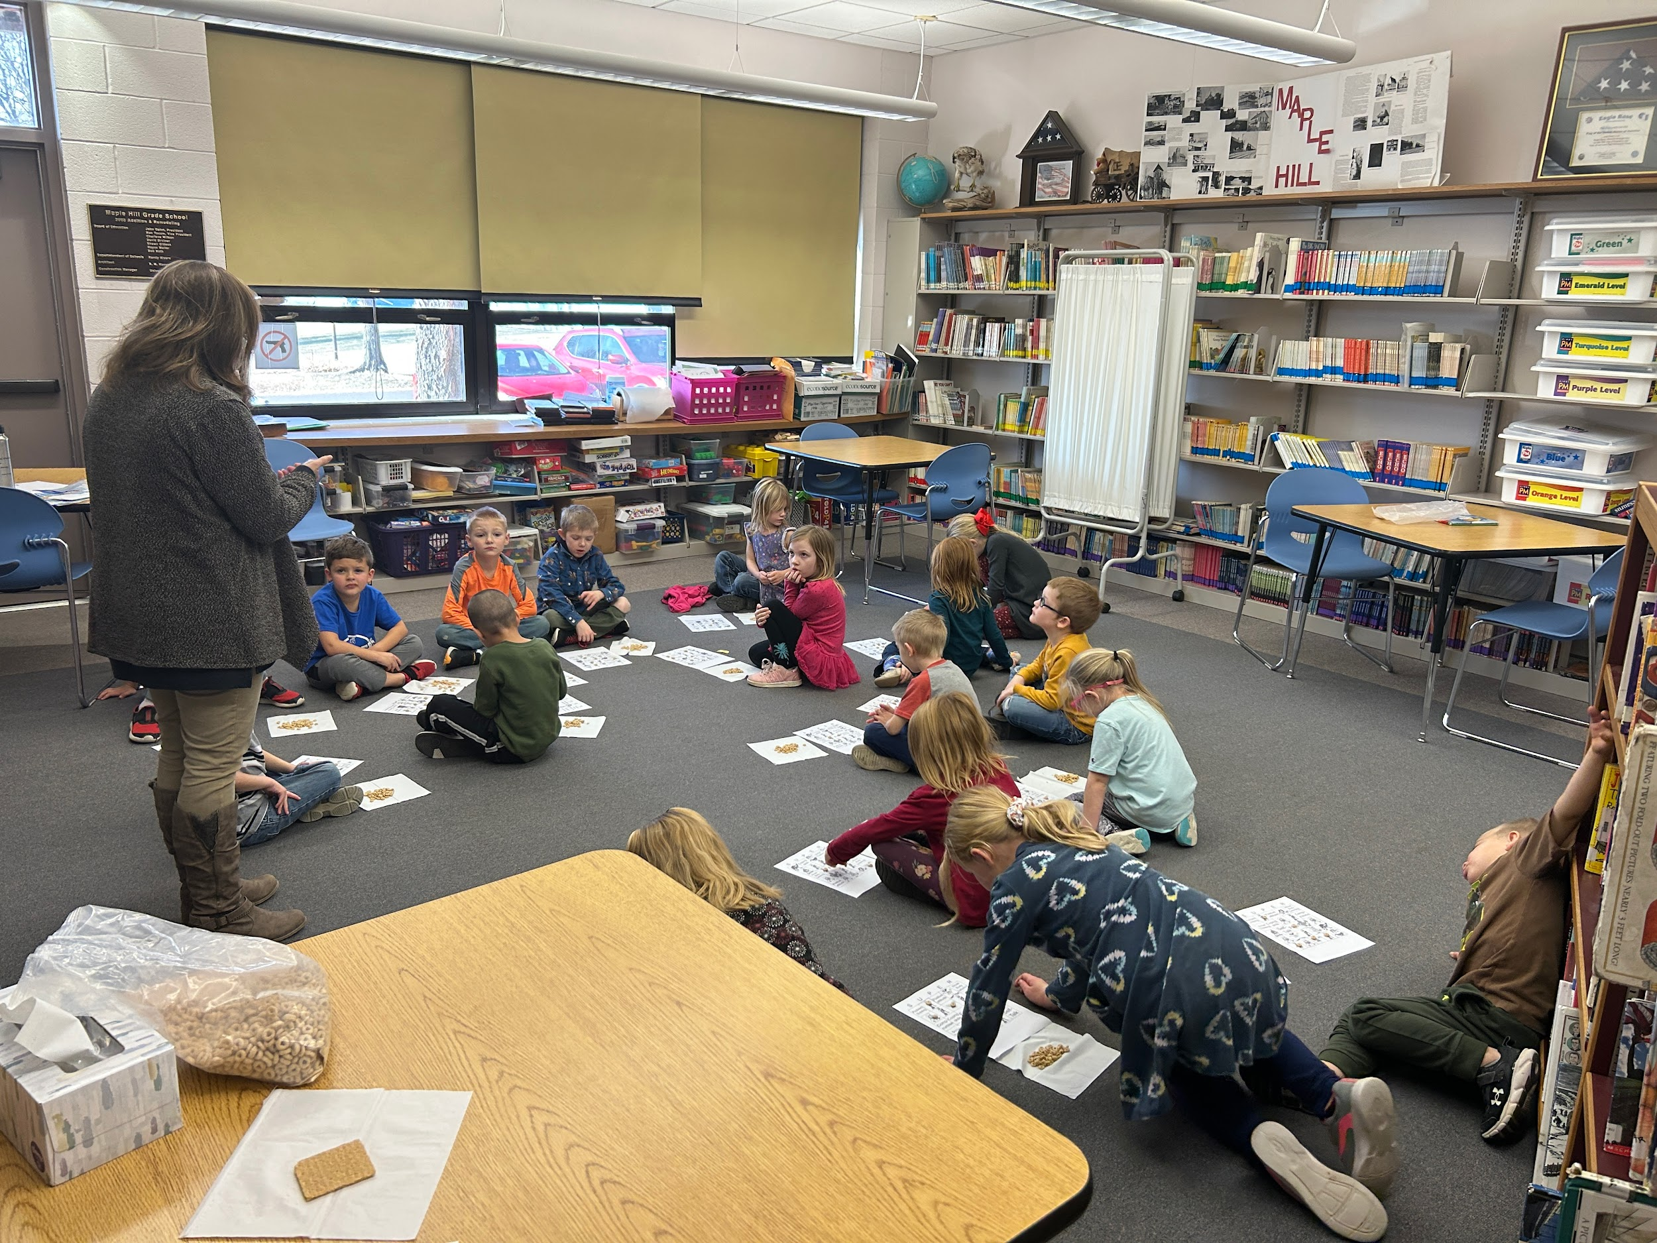
Charger Champions
Charger Champions are prek-3rd grade students who are recognized for their leadership abilities.
Nominations are made monthly.

Slide 19
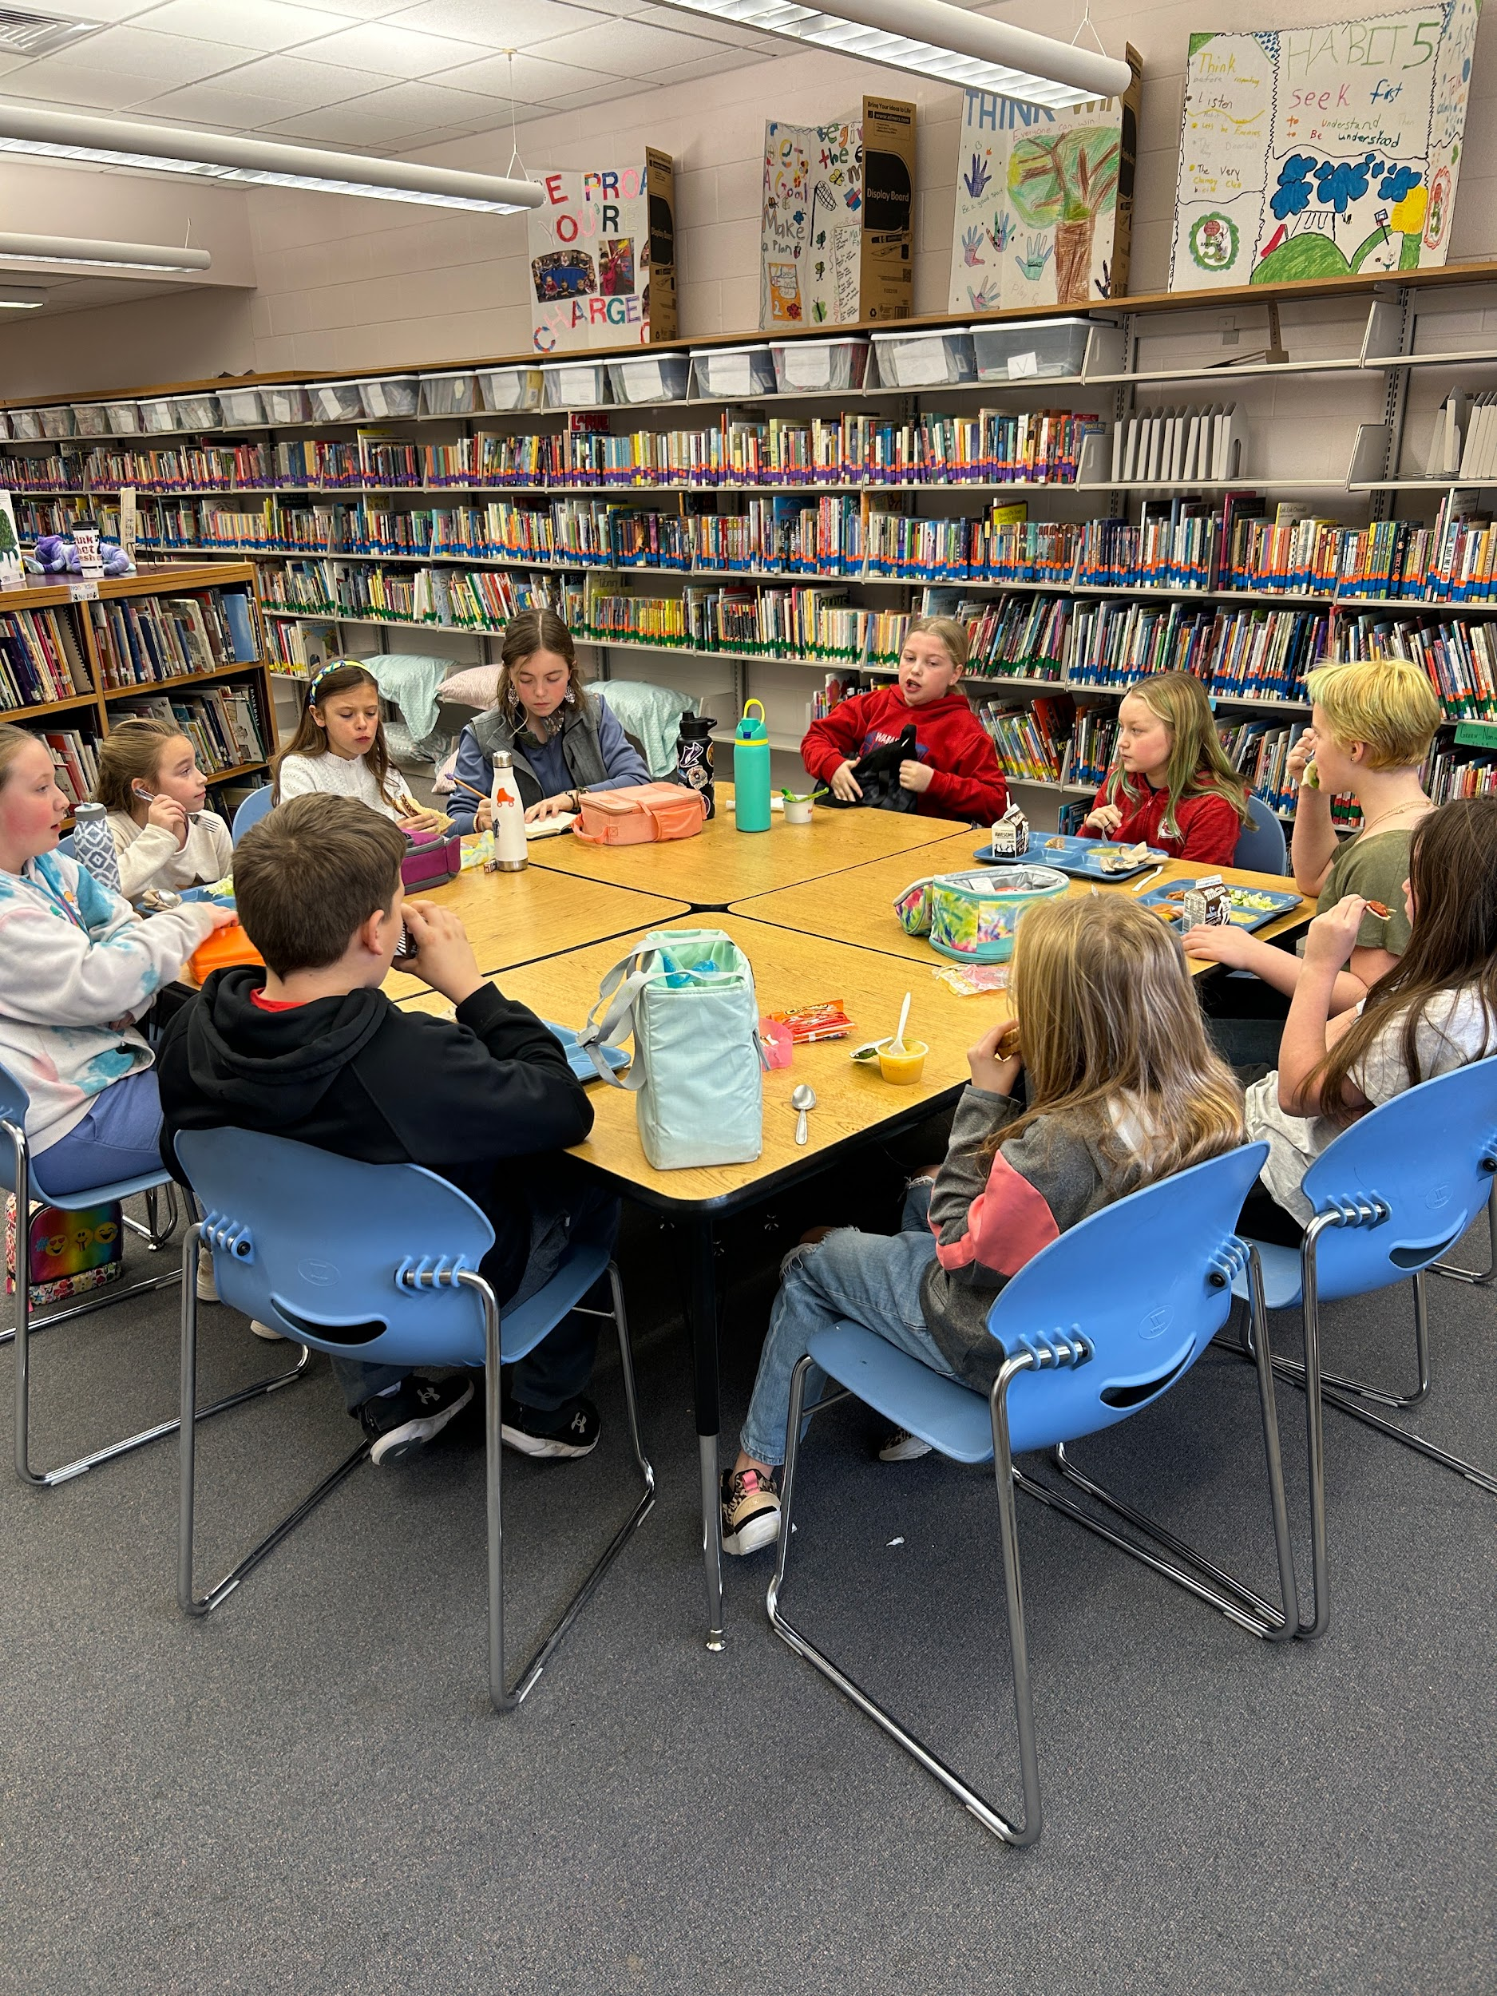
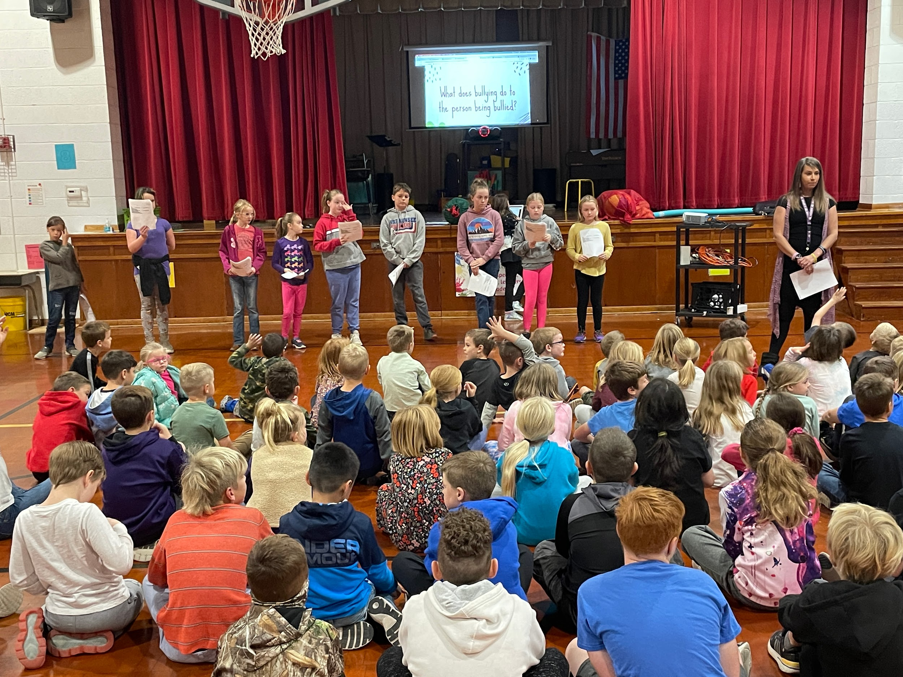
Kindness Crusaders
Kindness Crusaders are a group of 4th and 5th grade student leaders. Last year, they planned and delivered our annual Bully Prevention lessons to the whole building as one of their projects!

Slide 20
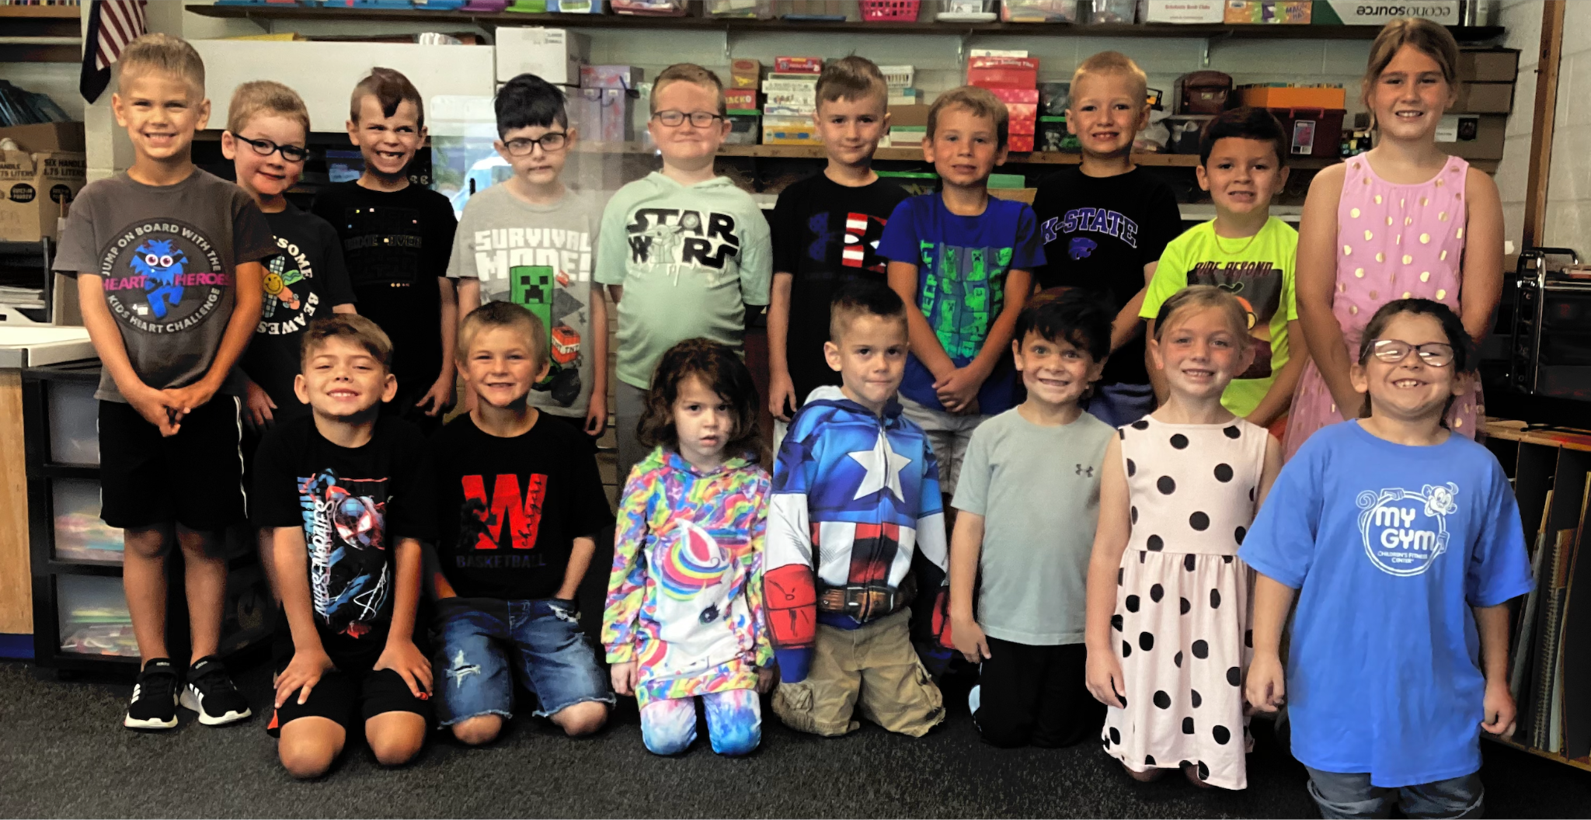

Slide 21


Slide 22


Slide 23
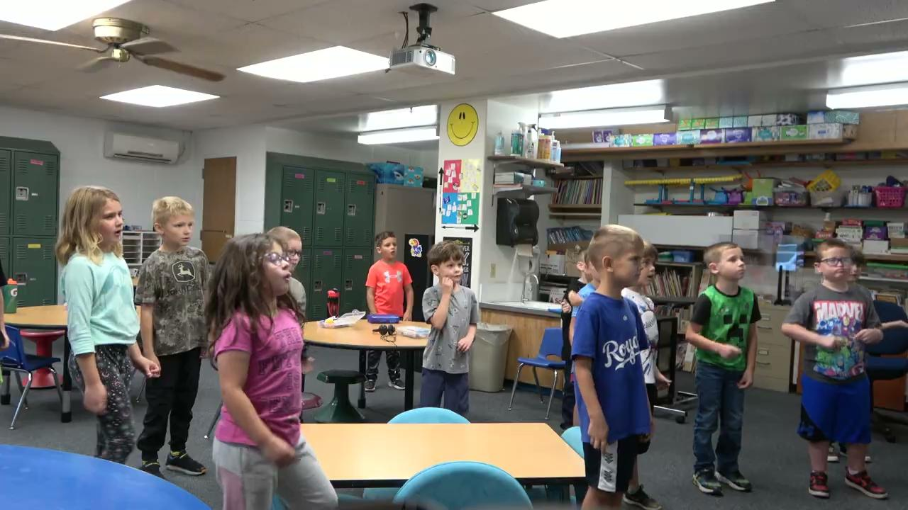

Slide 24
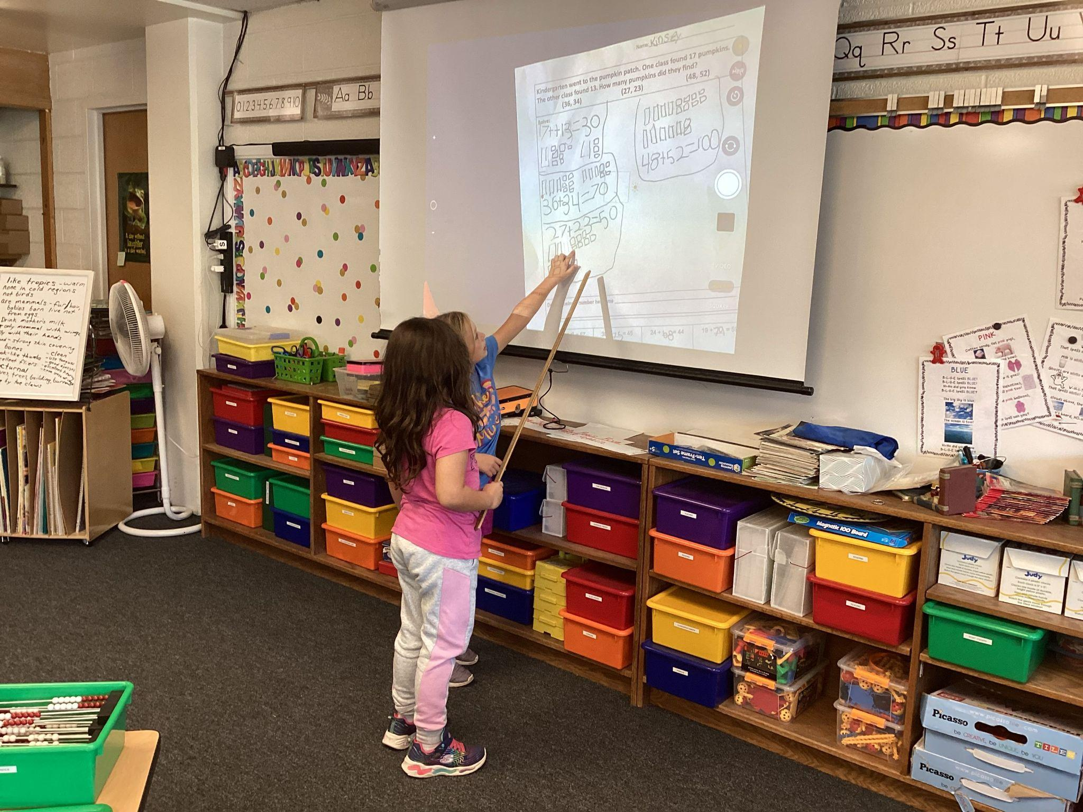

Slide 25
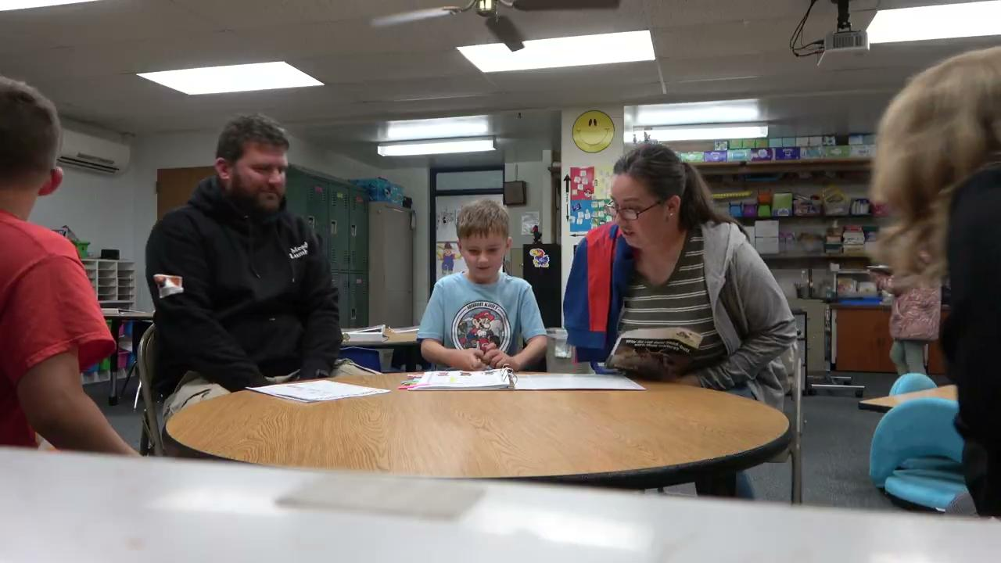

Slide 26
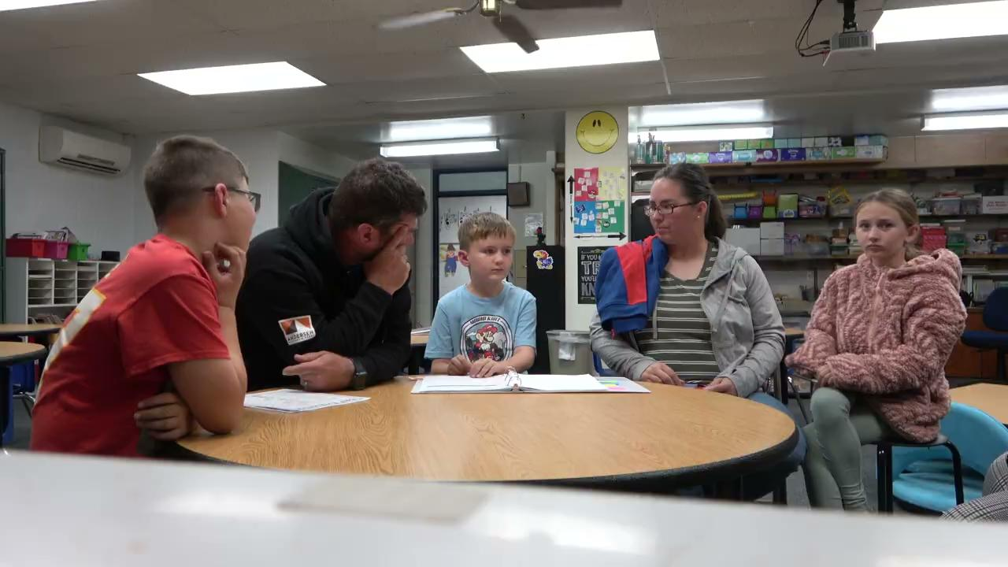

Slide 27
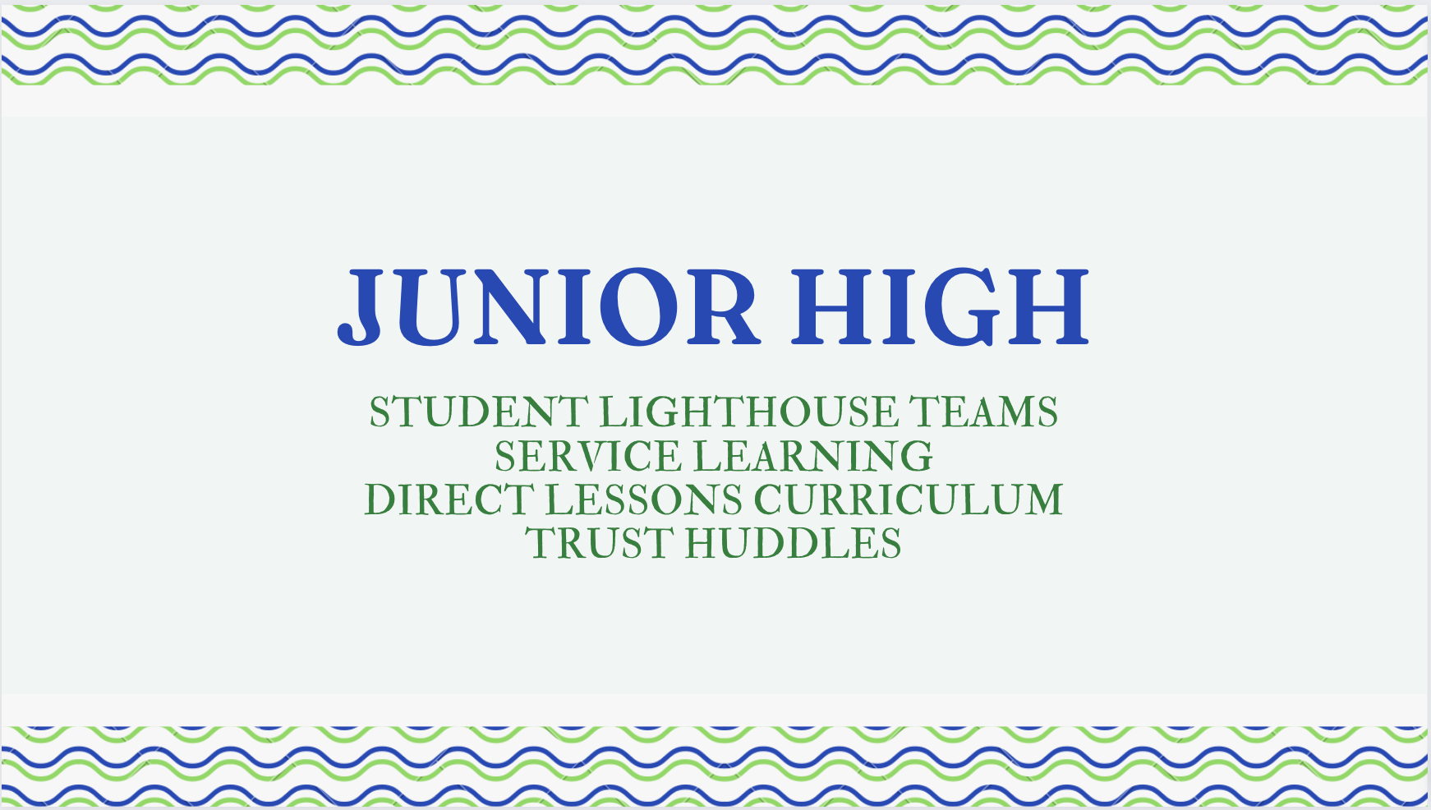

Slide 28

SHIFTING FOCUS
At the junior high level we shift our focus from direct instruction of habits to focus on Application and Practice and Processing the application of the skills.
Lighthouse Teams:
Bulletin Boards Lighthouse Team
Community Service Lighthouse Team
Event and Activity Lighthouse Team
Goal of Lighthouse Teams:
Putting the habits into practice
Problem solving strategies
Discussion on how to synergize-Habit 6, or cooperate, share ideas
RESULT: We are truly better together! Students also develop a deeper understanding of their special talents.
Leadership Council: Students must apply to be on this leadership team and interview with school staff.
This council practices leadership, decision making and plans school events.
Notes:
Students created bulletin boards for the school building and created newsletters to go home to parents about activities going on at the Jr. High. Students planned nonparishable food drives, community clean up efforts (raking leaves, picking up trash), and participated in beautifying flower beds around the school campus. Organized learning celebrations at the school which are an academic reward for student’ academic achievement.

Slide 29
MRA DATA AT THE JR HIGH
2021-2022 MRA (Measurable Results Assessments) survey data showed our focus needed to be on our school culture, and student’s feeling more sense of belonging to the school family. This need was met by facilitation of TRUST HUDDLES.
Trust Huddles are 15-week, student-led groups of 4-6 students.
Goals of Trust Huddles:
Students to form deeper connections with their trust huddle group
Refine their knowledge of trust concepts while working together to review habits and process how to apply habits to their lives
Students practice public speaking skills, take turns leading the group and practice creating and monitoring goals for the group.

Slide 30
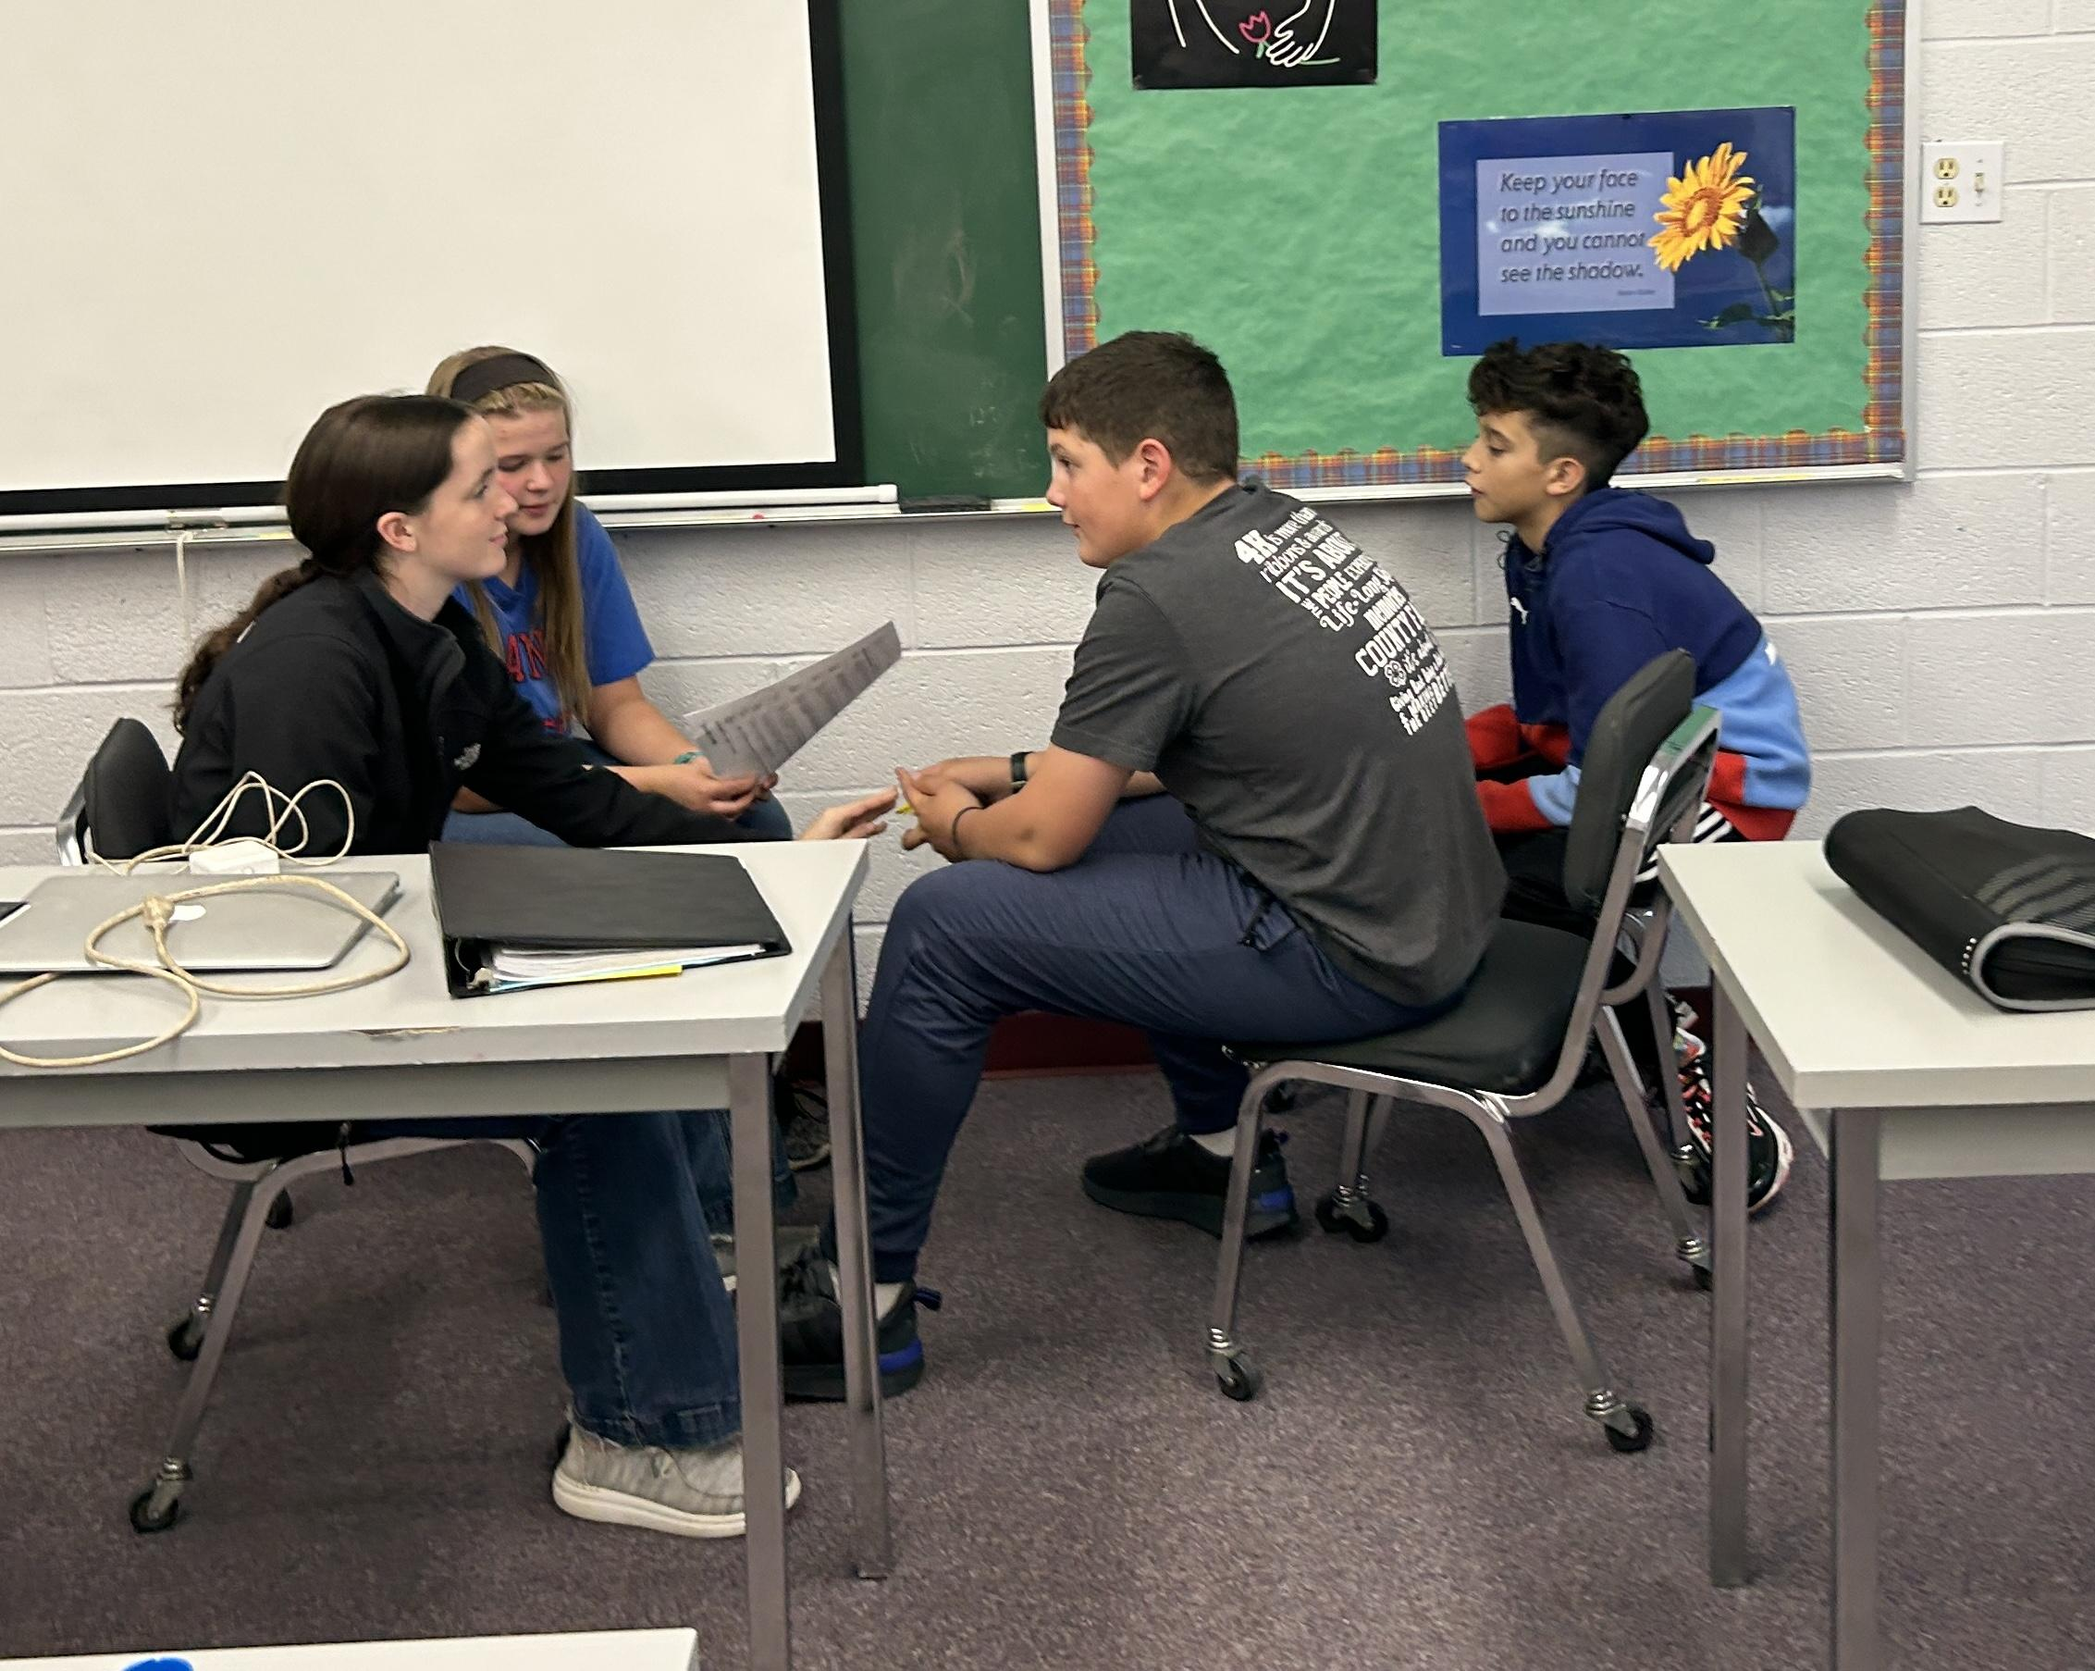
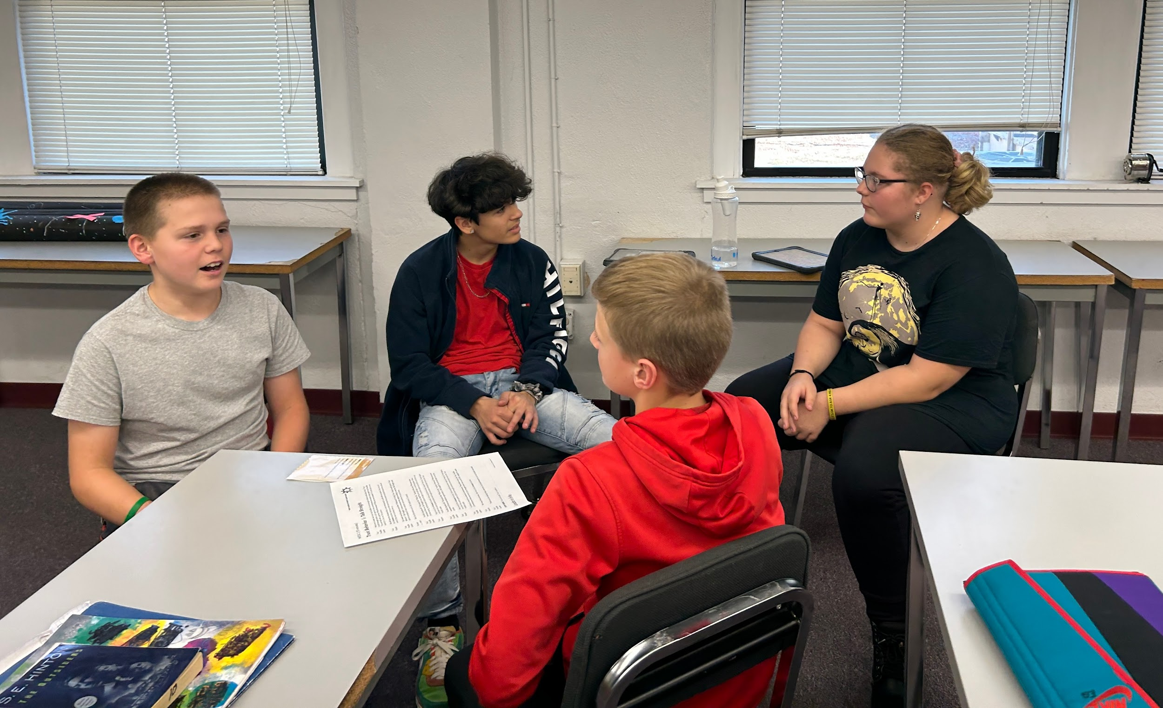
TRUST HUDDLES IN ACTION

Slide 31
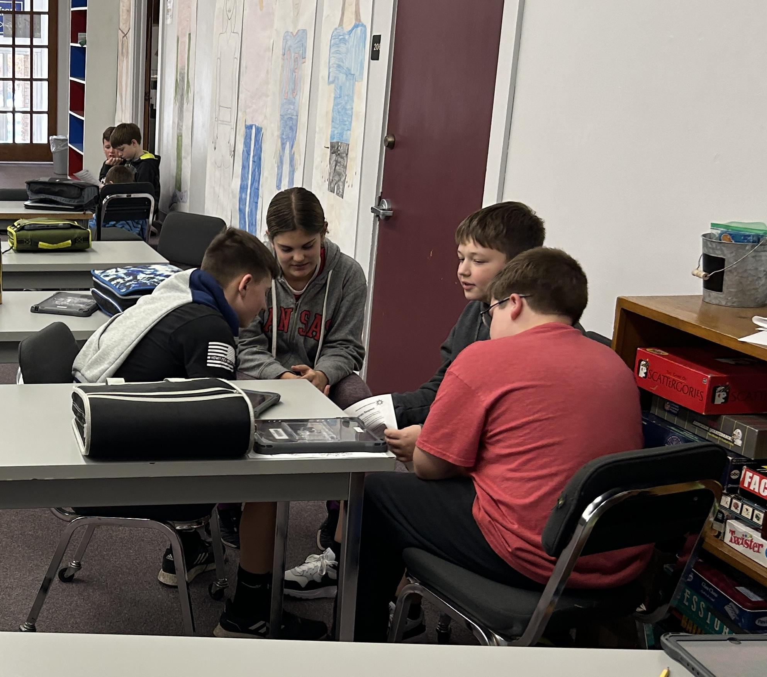
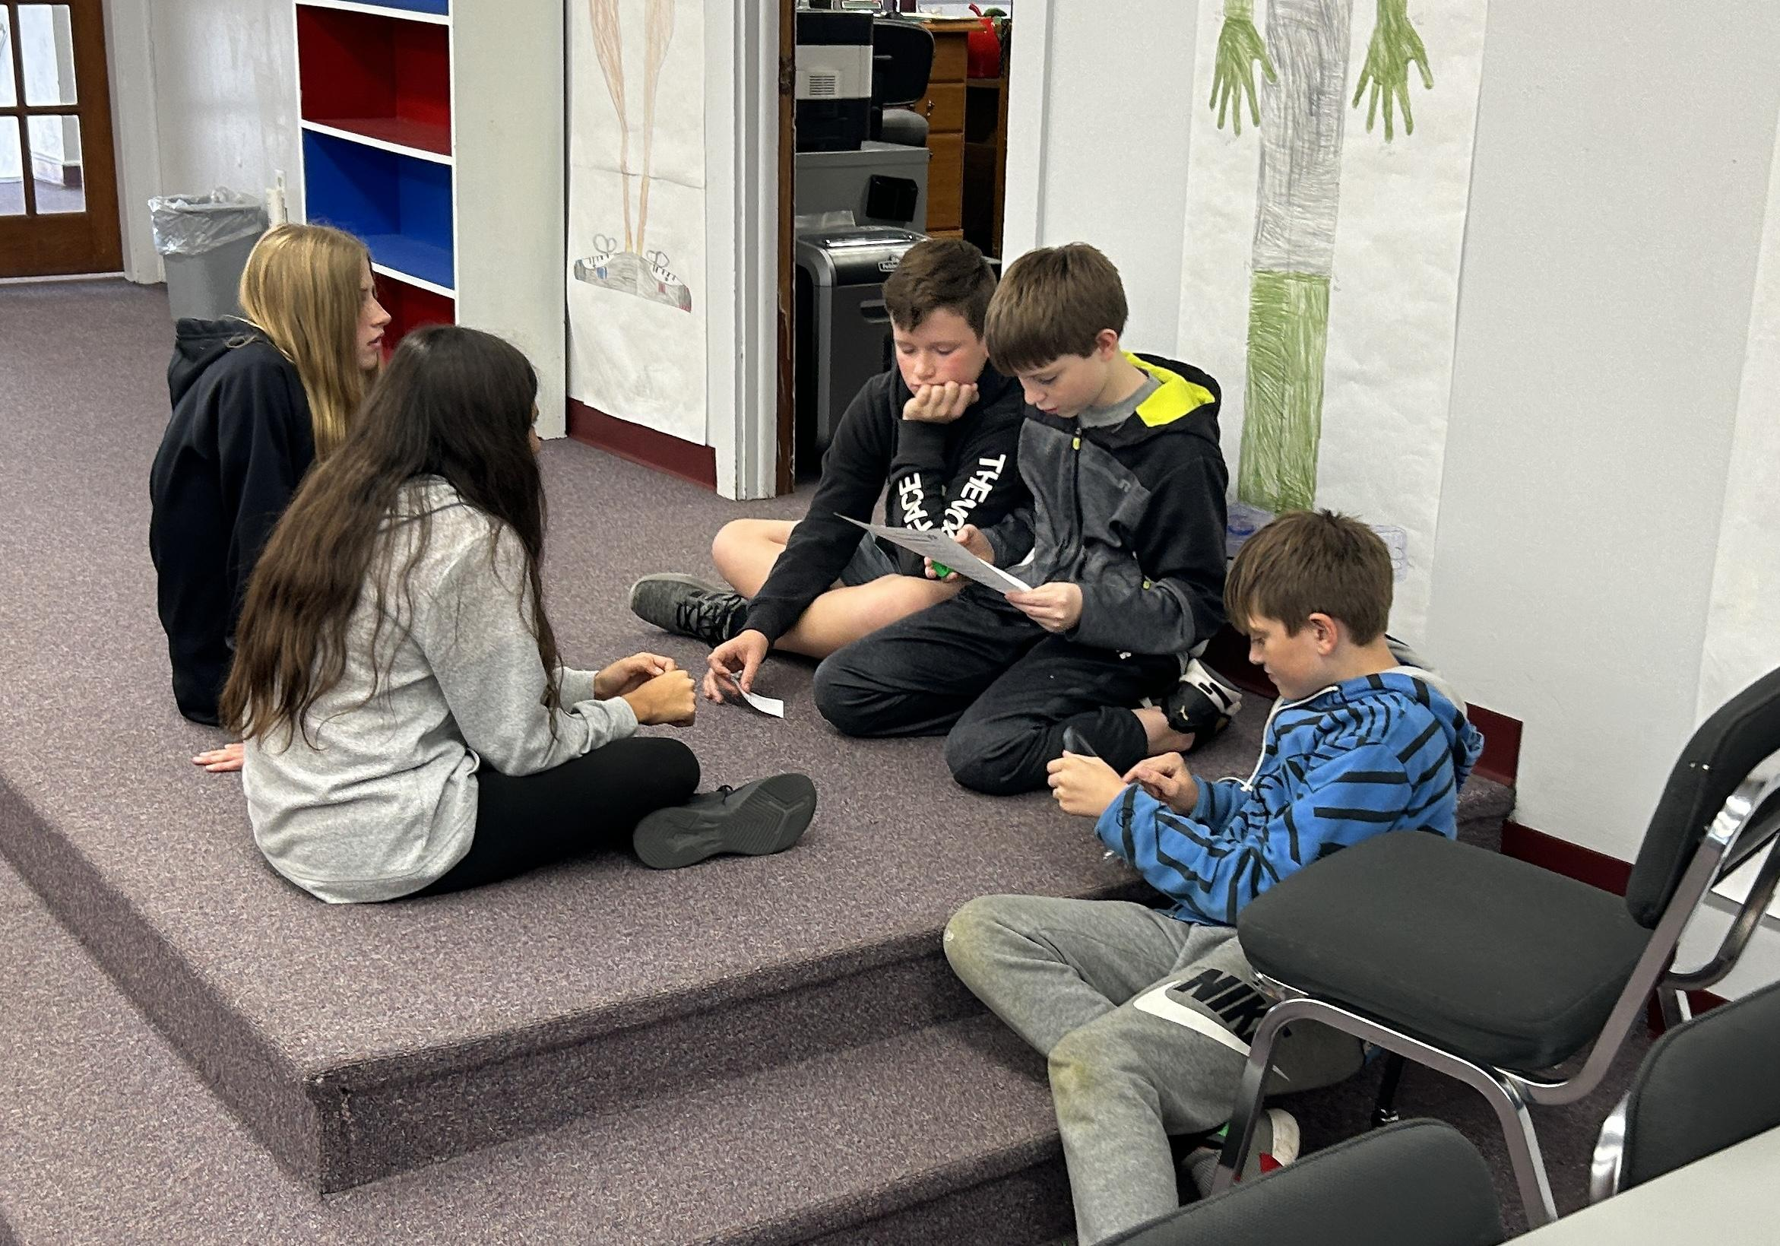
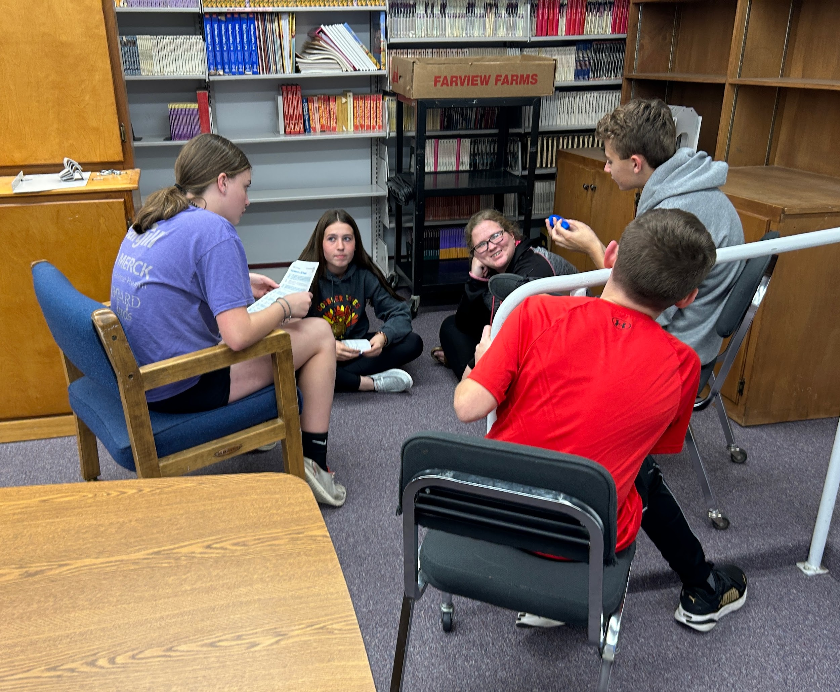

Slide 32
WEEKLY LESSONS AT THE JR HIGH
Although at the Jr High level the focus shifts our Jr High counselor continues to review Leader in Me Habits with weekly lessons.
These weekly lessons include reviewing the habits as well as practicing creating personal WIGS (Wildly Important Goals). Additionally, leadership notebooks are created for each student, which consists of items to contribute to their Individual Plans of Study when they get to the high school.

Slide 33
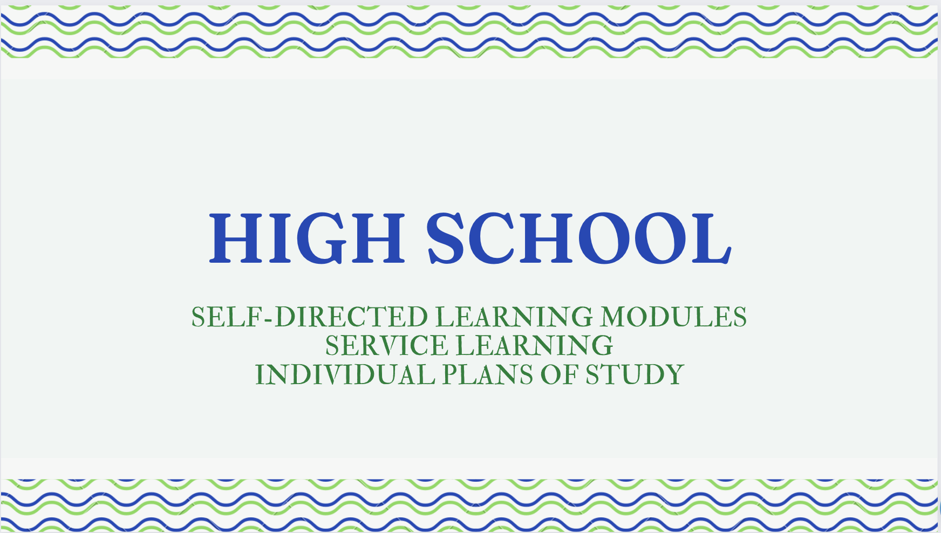
Notes:
Sarah

Slide 34
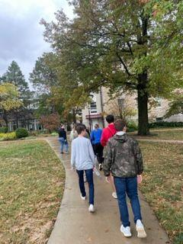
FINDING YOUR OWN VOICE
Self - Advocacy:
Students are taking charge of their learning and choosing their own path!
~Choosing appropriate classes for their desired post-high school plans
~Deciding where they want to focus their time (clubs, sports, work)
~Advocating for their needs
~starting clubs, seeking out learning opportunities, asking for help when they need it
~Refining and continuing to develop self-care strategies and healthy coping skills
Notes:
Sarah

Slide 35
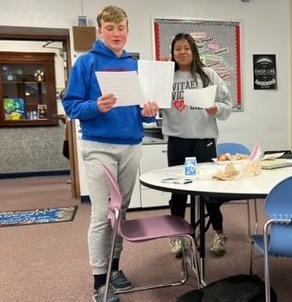
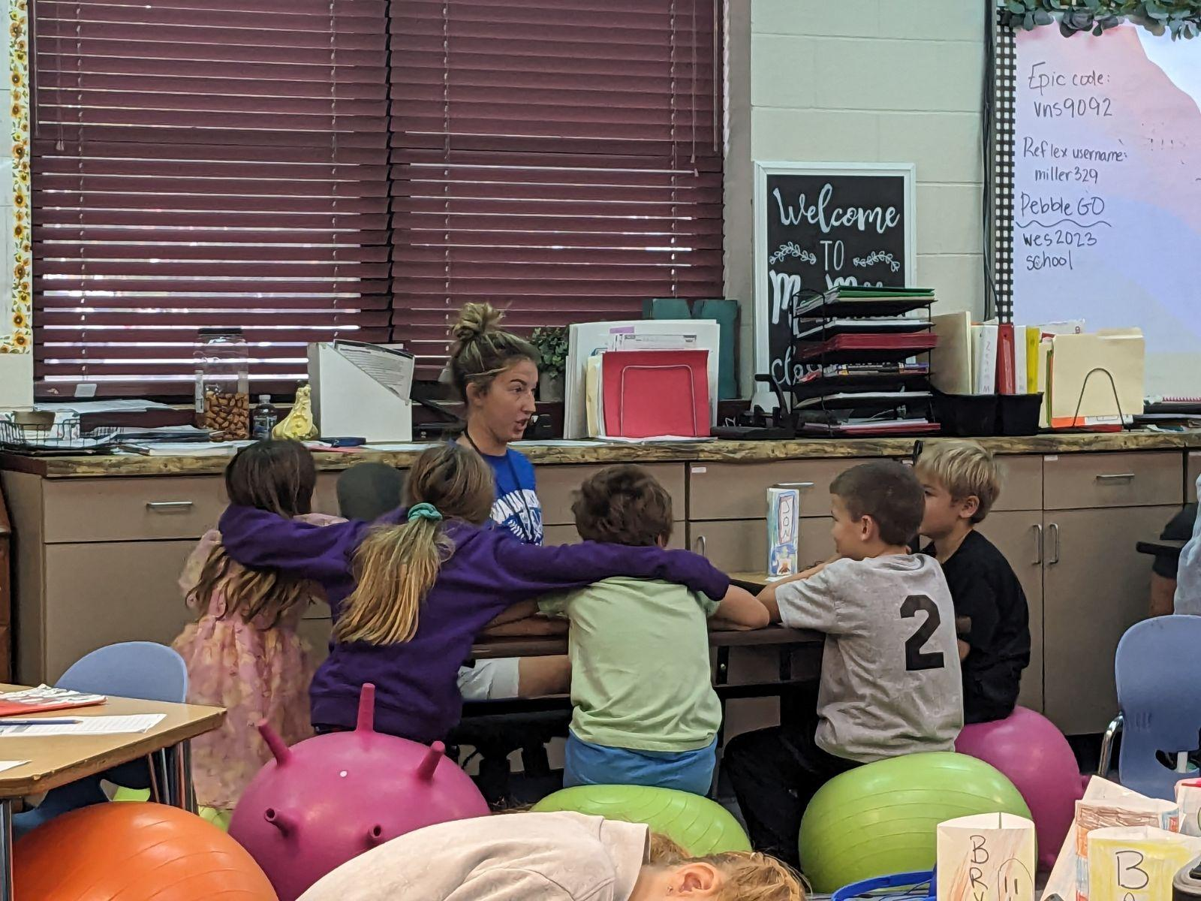
THE LEADER IN ME PUT INTO PRACTICE!
Leading by example:
~Clubs and organizations that are student lead (SAFE, FCCLA, FCA/Yellow Ribbon, KAYS, etc.)
~ Volunteering their time to help others (community open door - serving lunches, Turkey Trot 5K, Haunted trail, etc.)
~ Career and Community Connections class is overflowing! (grade school, coffee shop, teacher aide)
Notes:
Sarah

Slide 36
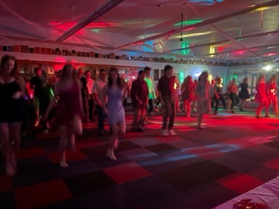
THINKING WIN-WIN
Winning is a group effort at Wabaunsee!
~Students supporting students:
Some examples…
Pep club - cheering each other on!
Fundraisers for students/families in need
Pumpkin patch help
Including everyone and encouraging each other to be themselves
Notes:
Sarah

Slide 37
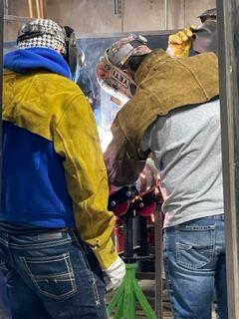
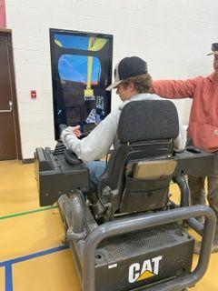
ALWAYS THINKING AHEAD
Career and college readiness - Beginning with the end in mind!
~Meeting regularly during advisor base and with the counselor
~Individual plans of study - tailoring academic goals to meet post-secondary goals
~Seeking opportunities to be informed about post-high school options
~Making connections with staff and other adults to help them gain valuable learning opportunities (FFA, 4H, FBLA, FCCLA)
Notes:
Sarah

Slide 38

Questions

