Slide 1
Enhancing Educational Success
Community Collaboration, Student Discipline, and Curriculum Review Cory Brewer
Education Counsel

Slide 2
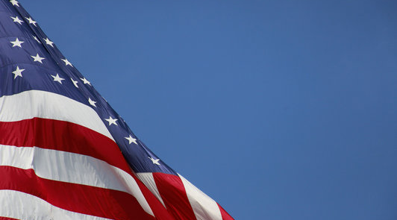
The Wisconsin Institute for Law & Liberty (WILL) is a non-profit law and policy center in Milwaukee, Wisconsin.
Through education, litigation and participation in public discourse, we work to advance limited government, free speech, transparency, and education reform.
We provide timely and comprehensive policy research to advance education reform, election reform, economic freedom, and policies to advance limited government.

Slide 3
Enhancing Educational Success
Engaging families and the community
Addressing student behavior effectively
Empowering school boards to shape educational outcomes

Slide 4
What is the Restoring American Education Project?
The pandemic revealed rifts in the public education of our children. Parents were provided a peek into the classroom and had questions and concerns about what their children were learning. The result has been a new wave of parental engagement and activism aimed at holding schools and school boards accountable for curriculum and academic proficiency.
An initiative of WILL to close a critical gap by engaging parents, school board members, and teachers with an understanding of these concerns, trends, and knowledge of the alternative resources available.

Slide 5
How can we ensure there are quality policies at the district level?
The growth of parent coalitions and wave of newly elected school board members has prompted important conversations about public school policies in communities across the country.
Many school board members encounter roadblocks or do not have access to resources about how to implement pro-parent and good governance policies.
WILL is addressing that gap through our model policies publicly available at www.SchoolBoardPolicies.org

Slide 6
Engaging Families and the Community

Slide 7
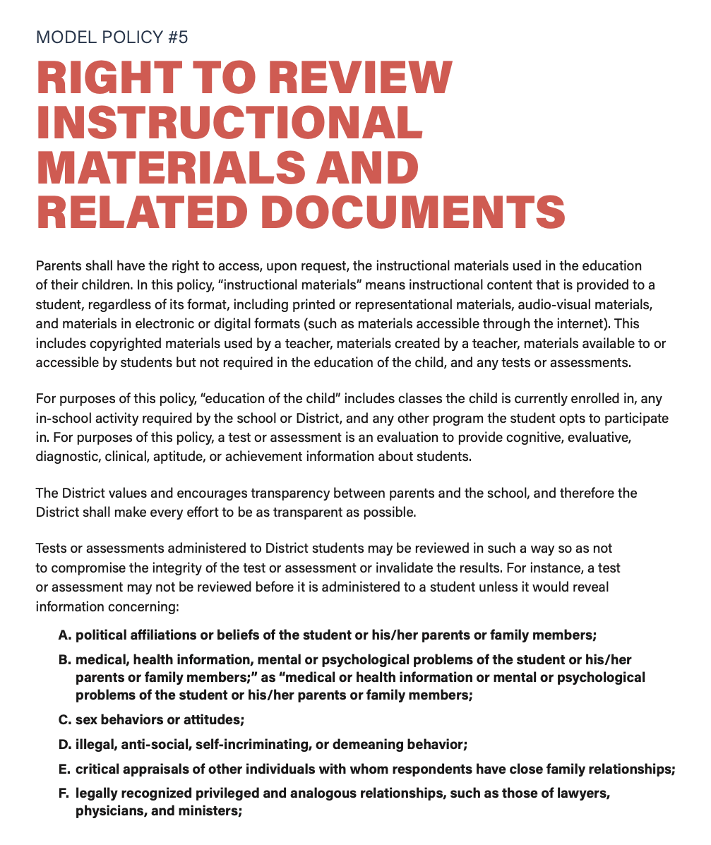
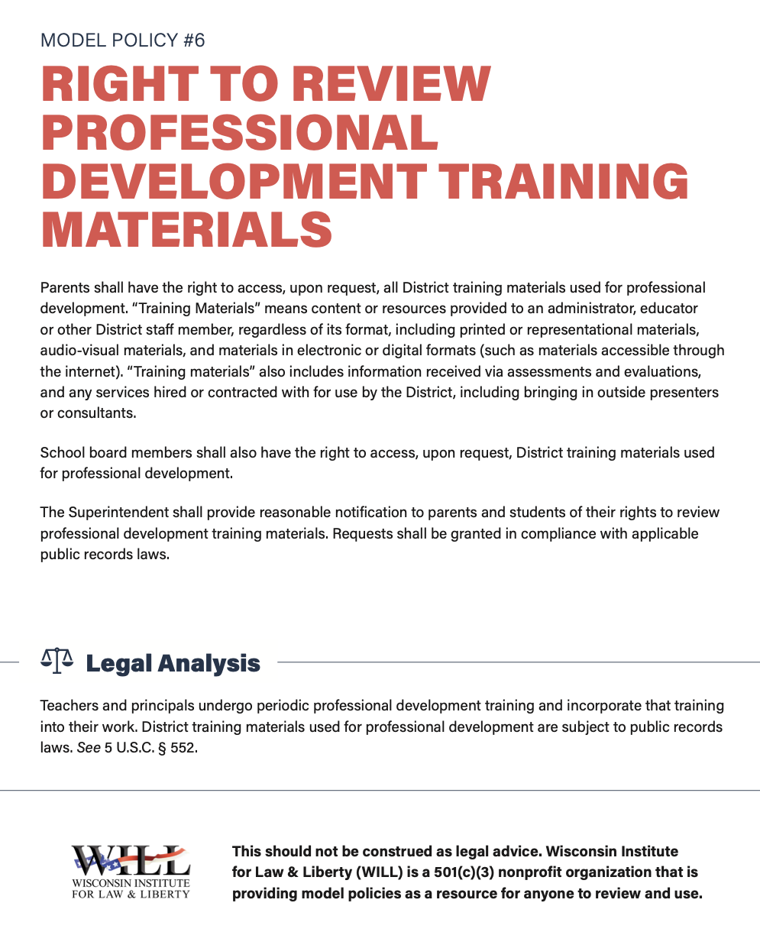
Notes:
Math proficiency was approximately 4.8% lower in districts that were closed for in-person learning in Fall 2020.
This represents approximately 30% of all students in the state.

Slide 8
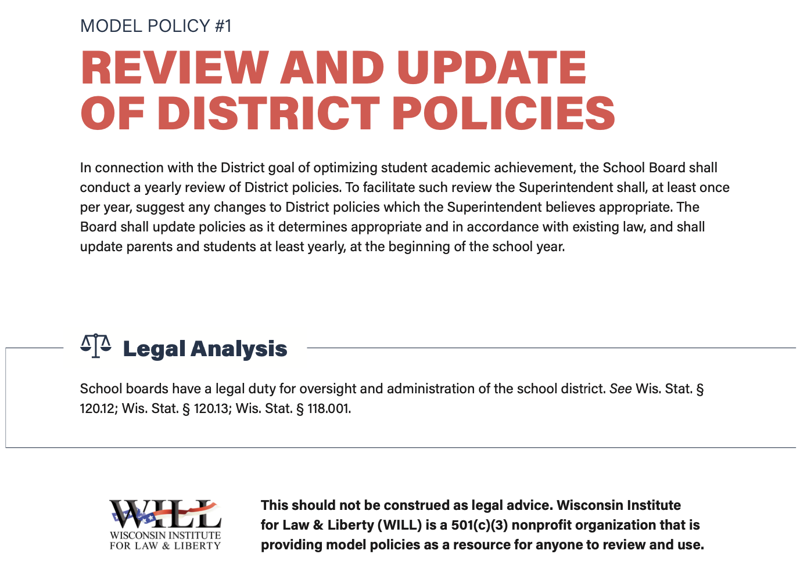
Policy Review 101

Slide 9
Framework for Assessment of Policies
A significant responsibility of every school board member is proposing, reviewing, and voting on policy.
Having a clear framework for policy review is key to adopting good policy for the district.
Whether making revisions to existing policies or introducing new and substantial changes, school boards should have an established process in place.

Slide 10
Assess Each Policy with a Goal in Mind
Review and update policies in light of the goal to optimize student achievement.
Consider reviewing and implementing good governance policies first.
What can school districts do to shift their perspective to treating parents as equal partners in the education of their children?

Slide 11
Invite Suggestions and Feedback
Before conducting review of policies, consider inviting suggestions from parents, teachers, administrators, and district community members.
Consider adopting or revising policies to encourage communication between the board and superintendent.

Slide 12
Increase Transparency
Consider creating a schedule to review and update policies on a regular basis.
Hold public meetings to listen to suggestions and to encourage community involvement.

Slide 13
Understand Consequences
Policies prioritizing parental rights and age-appropriate content in schools have unfortunately garnered opposition from the establishment and some media.
For policies on more controversial topics, take time to review applicable laws, discuss with district legal counsel, and consider intended and unintended consequences.
Policies should be workable both for school district officials implementing them and for students and families.

Slide 14
Considerations for Policy Review
Consider adopting good governance policies first.
Know what policies are currently in place.
Invite suggestions and feedback.
Increase transparency.
Understand applicable laws and assess intended and unintended consequences. Ask for regular updates from local counsel about changes to state and federal laws and regulations.

Slide 15
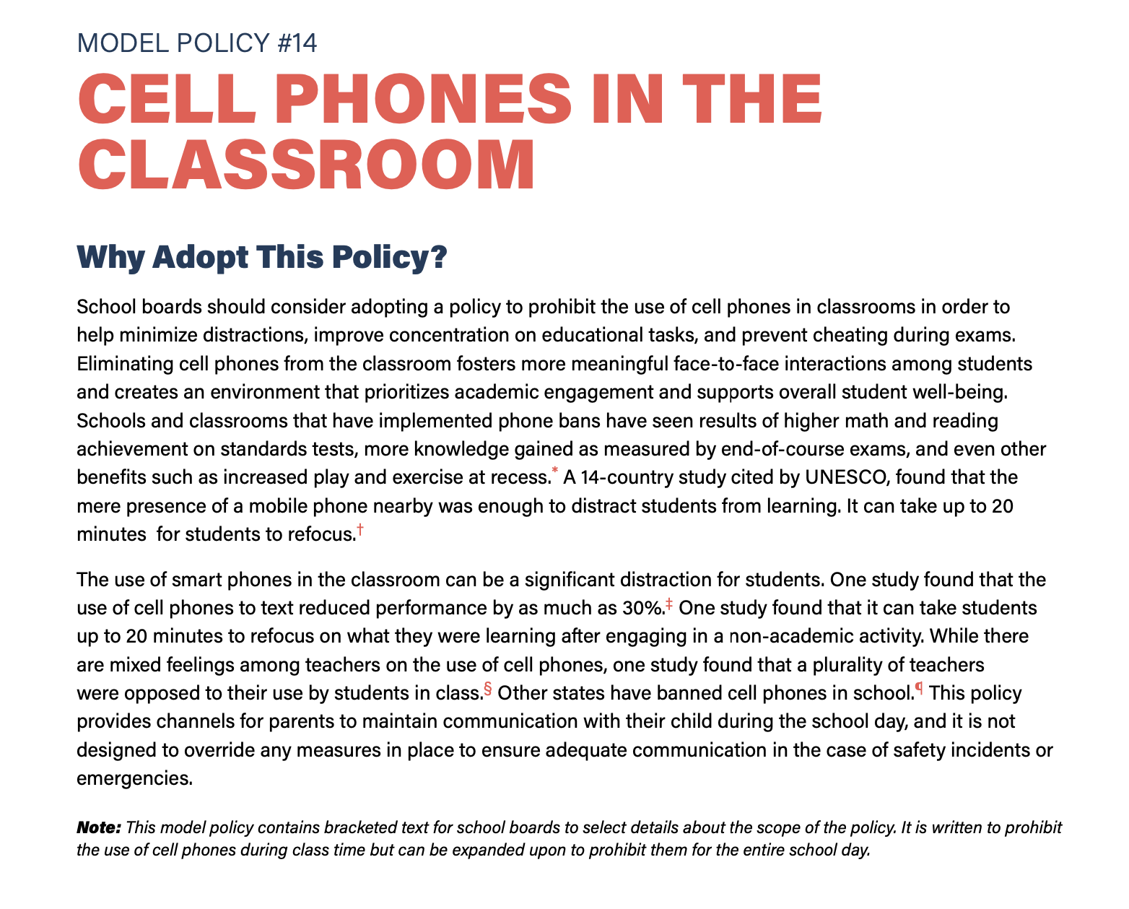
Managing Student Behavior Effectively

Slide 16
Managing Student Behavior Effectively
“Alas, my experiences reflect systemic changes across American education, new approaches to discipline and order. The old behavioral codes are going down, one by one—that’s what I’ve observed in the last few years. School districts, including my own, rely ever less on suspensions and expulsions, replacing them with novel approaches such as 'restorative justice.’”
Daniel Buck, Don’t Spare the Rod
https://www.firstthings.com/article/2023/06/dont-spare-the-rod

Slide 17
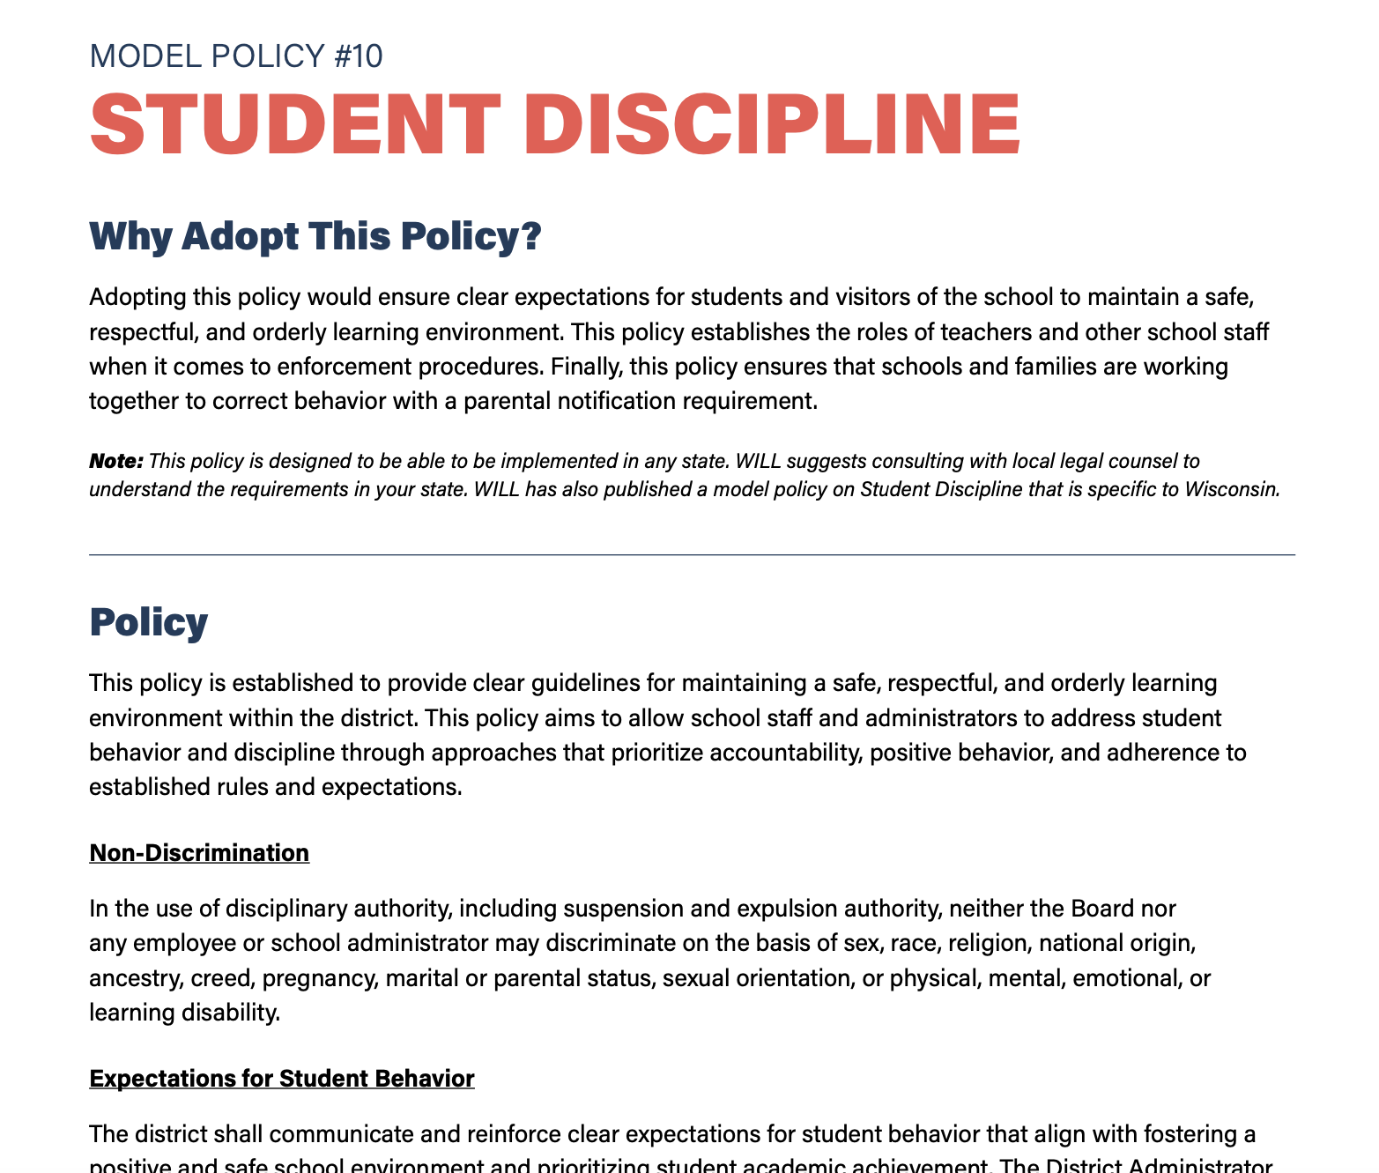
Managing Student Behavior Effectively

Slide 18
Biden Discipline Guidance
“Resource on Confronting Racial Discrimination in Student Discipline” by the U.S. Department of Education and U.S. Department of Justice
Title VI of the Civil Rights Act of 1964
WILL memo available at www.SchoolBoardPolicies.org and additional resource coming soon!

Slide 19
Shaping Educational Outcomes

Slide 20
Shaping Educational Outcomes
Public school board members should be familiar with landmark Supreme Court decisions that could shape how they resolve conflicts and set school district policies.
Students generally enjoy more First Amendment rights than teachers do. Settings and circumstances dictate when and where teachers are at liberty to indulge in free expression, but when it comes to the classroom, school boards set the curriculum, and teachers must follow it.

Slide 21
QUESTIONS?

Slide 22
Contact WILL
Cory Brewer
cbrewer@will-law.org
Lauren Greuel
lauren@will-law.org
www.RestoringAmericanEducation.org

