Slide 1

Dave Trabert
Kansas Policy Institute
Kansas School Board Resource Center

Slide 2
Lesson 1: Realities of Student Achievement
In most cases, outcomes are much lower than parents have been led to believe.
  Below the national average for several years.
  Not among the ten best as claimed by KASB.

Slide 3
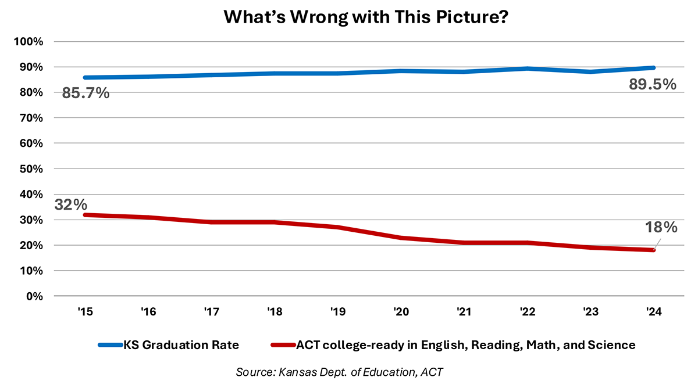
Lesson 1: Realities of Student Achievement

Slide 4
Lesson 1: Realities of Student Achievement

Slide 5
Lesson 1: High School (10th-Grade) Results

Slide 6
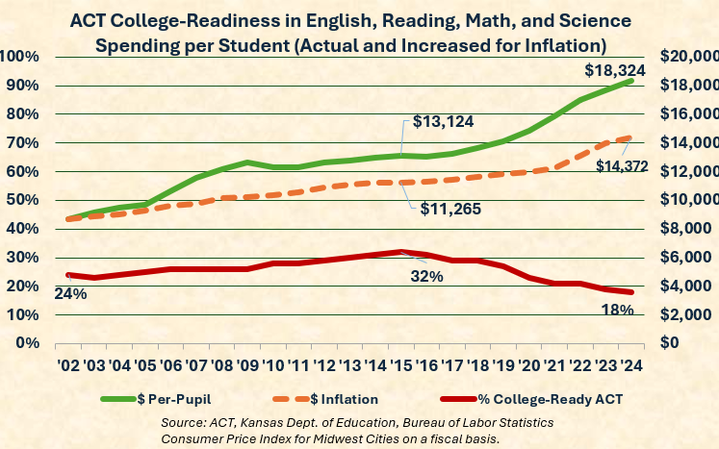
Lesson 1: Low College Readiness

Slide 7
Lesson 2: District’s purpose is to improve student outcomes
“School systems do not exist to have great buildings, have happy parents, have balanced budgets, have satisfied teachers, provide student lunches, provide employment in the county/city, or anything else. Those are all means—and incredibly important and valuable means—but none of them are the ends. They are all inputs, not outcomes. None of those are measures of what students know or are able to do.” AJ Crabill, Great on Their Behalf

Slide 8
Lesson 2: District’s purpose is to improve student outcomes
The district’s purpose should be to improve student outcomes, and that should also be a candidate’s purpose for running.
Door-knocking script, other messaging techniques.

Slide 9
Lesson 2: Discuss social issues through a student outcome lens
DEI premise – students will learn more if they feel welcomed.
Outcomes for Blacks and other minorities haven’t improved, so help me understand why we should divert time and resources to anything that isn’t producing the expected results.

Slide 10
Lesson 2: Student-focused or System-focused
Don’t use labels like Republican, conservative, or liberal.
Student-focused principles:
  Budgets are built from the classroom first.
  Curriculum and teaching methods are devoid of politics and social agendas, focusing solely on improving proficiency levels with proven instructional techniques

Slide 11
Lesson 3: Student outcomes won’t change until adult behaviors change
Examples of adults resisting change:
  Not allowed to visit schools
  Sanctioning board members who don’t support the majority
  Breaking laws designed to improve student outcomes

Slide 12
Lesson 3: Create a building needs assessment process to force change
Most school boards don’t conduct meetings
Board members should meet with teachers & principals
Identify proficiency barriers in the school
Reallocate budget resources to overcome the barriers
Science of Reading

Slide 13
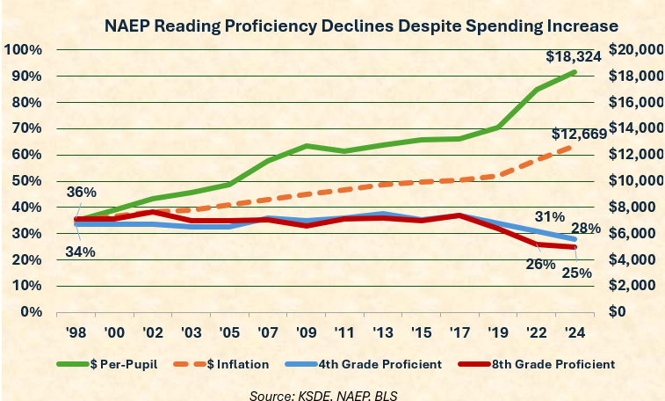
Lesson 4: Basics of school Finance
No relationship between money and achievement

Slide 14
Lesson 4: Employment vs Enrollment

Slide 15
Lesson 4: Spending Per Student
Inflation was 55%

Slide 16
Lesson 4: Spending Per Student

Slide 17
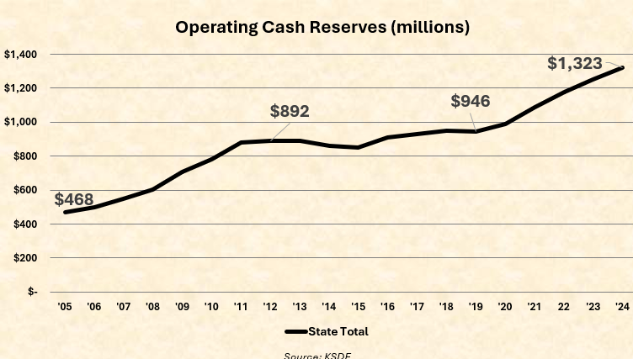
Lesson 4: Fund Accounting / Cash Reserves

Slide 18
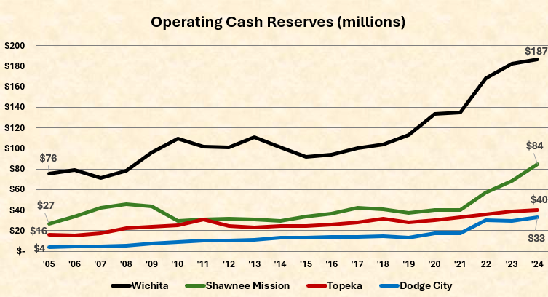
Lesson 4: Fund Accounting / Cash Reserves

Slide 19
Lesson 5: Six Powers of Persuasion – Melanie Sturm
You are the Message!
Find Common Ground
Fight for people, not things
Use a Fairness and Compassion Frame
Connect with Storytelling
Pivot to Better Ground

Slide 20
Lesson 6: Being Effective in the Minority
Introduce yourself and your student-focused approach to board members.
Show me your work
Explain your vote
The army form of discipline
Anticipate challenges to lack of education credentials

Slide 21
Lesson 7: Ask Probing Questions
Use your rookie status to your advantage
Turn shiny objects like daycare and affordable housing into teaching moments

Slide 22
Lesson 8: Represent your community
Representing community interests rather than one’s personal views or the district’s desire is (a) what you are elected to do and (b) de-escalates discussions.
Visions and values
Above average is not ‘mission accomplished’
Public opinion survey: 84% strongly/somewhat agree parents should have primary say in child’s education

Slide 23
Final Thoughts
Make everything about improving student achievement
Always be the adult in the room; credibility is your currency
Never make it personal … about you or anyone else

