Slide 1
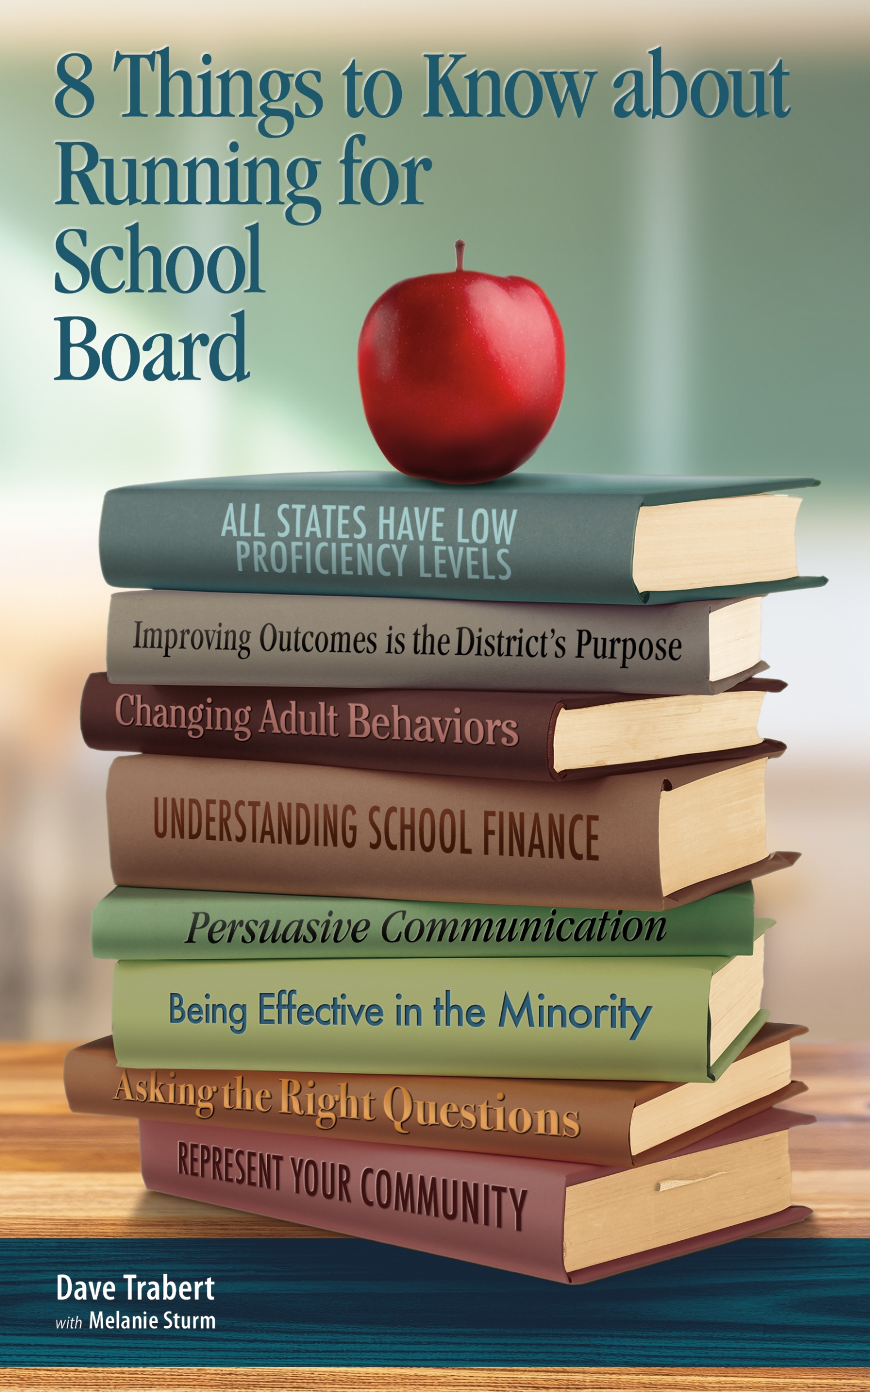
School Board Training Academy
Lessons 1 and 2
Dave Trabert
Kansas Policy Institute
Kansas School Board Resource Center

Slide 2
Lesson 1: Realities of Student Achievement
In most cases, outcomes are much lower than parents have been led to believe.
  Below the national average for several years.
  Not among the ten best as claimed by KASB.
School officials cite rankings when they don’t want you to look at outcomes.

Slide 3
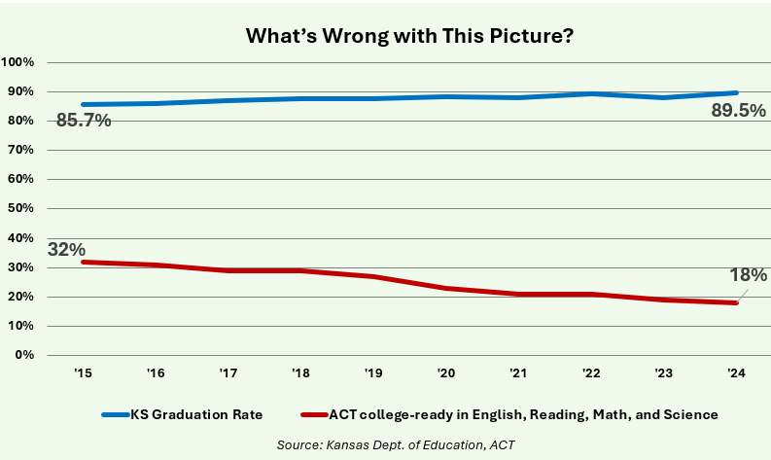
Lesson 1: Realities of Student Achievement

Slide 4
Lesson 1: Realities of Student Achievement

Slide 5
Lesson 1: High School (10th-Grade) Results

Slide 6
Lesson 1: Longitudinal trend

Slide 7
Lesson 1: Income-based gaps (Math)

Slide 8
Lesson 1: Income-based gaps (ELA)

Slide 9
Lesson 1: Why state assessments are needed
Some people question the need for assessments, arguing that a single test result does not necessarily represent a student’s knowledge.
Every Student Succeeds Act requires states to have an assessment test.
Federal intervention aside, local school boards need an independent means of measuring progress.

Slide 10
Lesson 1: Why state assessments are needed
Rampant grade inflation invalidates report cards.
Students not at grade level have a low chance of catching up. State assessment data identifies students individual needs, and also schools and districts overall.
Longitudinal data is needed to measure progress and the possible need for systemic change.

Slide 11
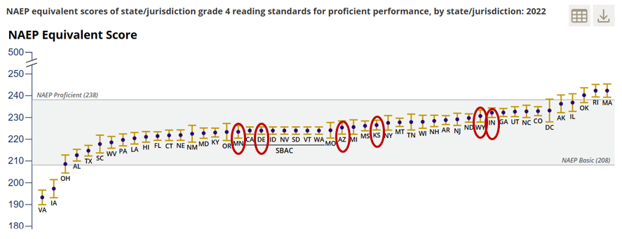
Lesson 1: Many states have low standards
https://nces.ed.gov/nationsreportcard/studies/statemapping/

Slide 12
Lesson 1: Low standards = inflated outcomes
The Massachusetts state standard translates to NAEP Proficient; the other states listed have state standards that translate to NAEP Basic.

Slide 13
Lesson 1: Deceptive PLDs
Performance level descriptors (PLDs) are often deceptive by design.
Can’t take words at face value; proficient isn’t always proficient.
Test for consistency with ACT, SAT, NAEP.

Slide 14
Lesson 1: Deceptive PLDs
North Carolina Reading Grades 3–8 Achievement Levels
Achievement Level | Meets On-Grade-Level Proficiency Standard | Meets College-and-Career Readiness Standard
Level 5 | Yes | Yes
Level 4 | Yes | Yes
Level 3 | Yes | No
Not Proficient | No | No
Why is grade level proficiency not C&C ready?
Why skip Levels 1 & 2?

Slide 15
Lesson 1: Kansas deception by design
KSDE Actual and Proposed
Original in 2015 | Below Grade Level Removed in 2018 | Proposed February 2025 | Proposed April 2025
L4 Excellent, Academically Prepared | No Change | Exceeds Expectations | L4 Excellent, Academically Prepared
L3 Effective, Academically Prepared | No Change | Meets Expectations | L3 Effective, Academically Prepared
L2 Basic, Grade Level | Basic | Working Toward Expectations | L2 Basic
L1 Limited, Below Grade Level | Limited | Identified Need | L1 Limited
No one below grade level

Slide 16
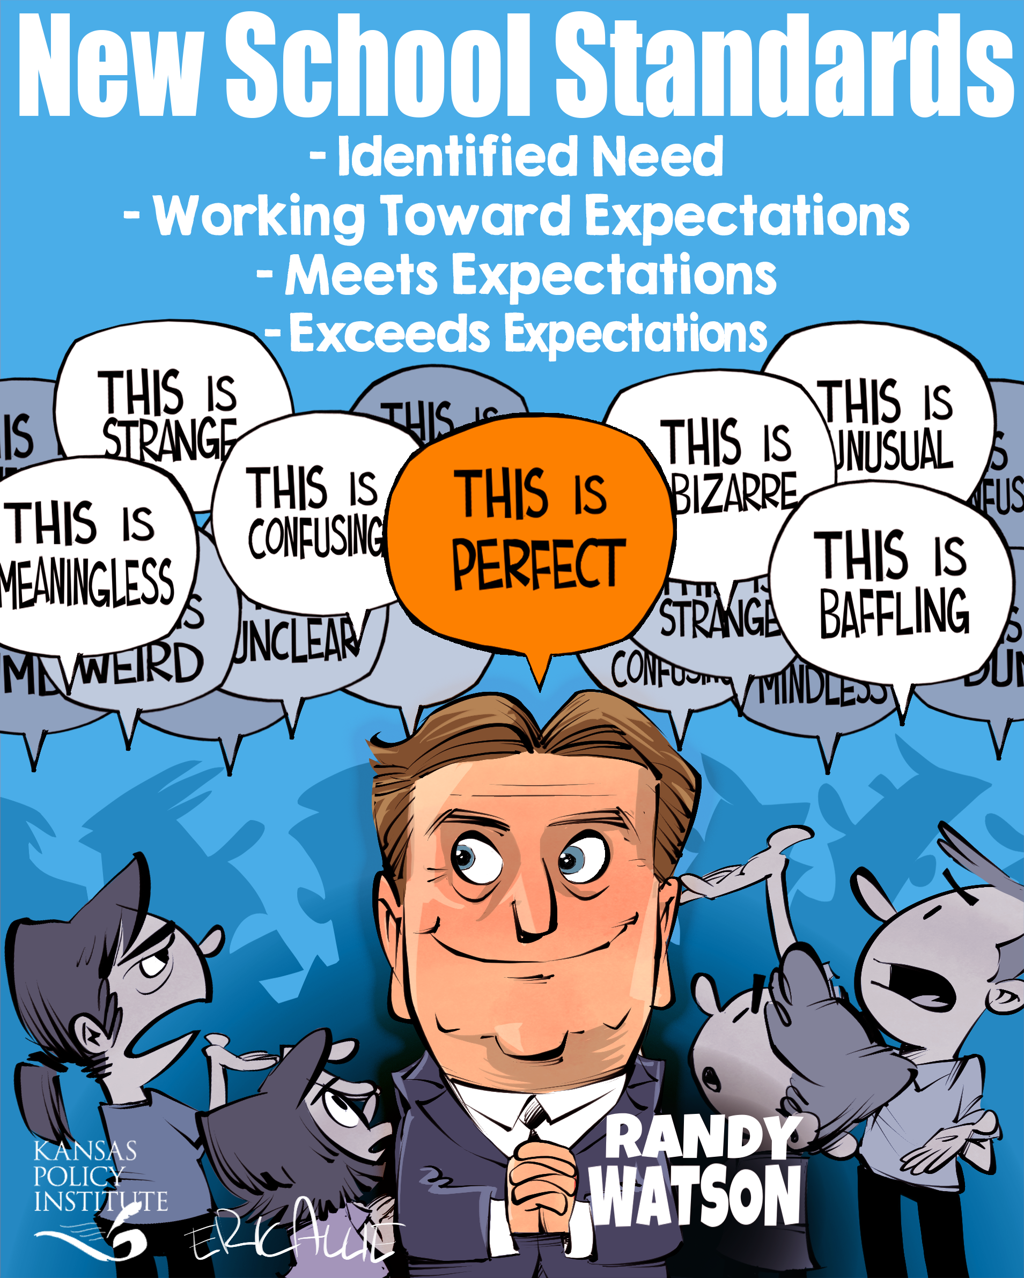
Lesson 1: Humor is effective messaging

Slide 17
Lesson 1: Ask probing questions
  Randy,
  KSDE maintains it is incorrect to say that any portion of Kansas students are below grade level based on state assessment results because the test only measures grade-level performance.
  Yesterday, you were quoted by the Kansas Reflector saying, “A lot of research says if you’re not at that grade level by the time you hit third grade, it’s really hard to catch up, and most do not,” he said. “In fact, more fall further behind.”
  If the state assessment doesn’t indicate that any students are below grade level, how do KSDE and school districts determine whether students need help to catch up to grade level?

Slide 18
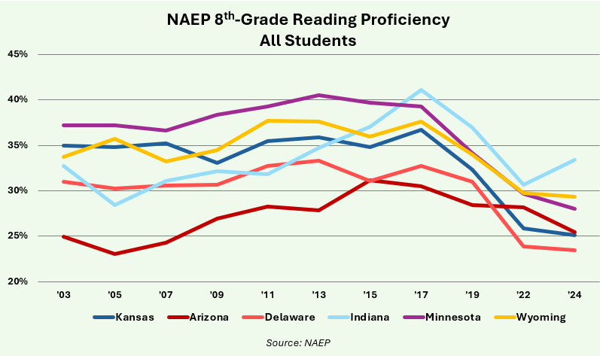
Lesson 1: Outcomes declining in many states
COVID is not the cause of low outcomes

Slide 19
Lesson 1: Income- and race-based gaps

Slide 20
Lesson 1: Composite scores decline
How do we justify devoting time and resources to DEI programs that are not improving outcomes as hoped?
Change in 4-score composite (4th-grade and 8th-grade reading and math)

Slide 21
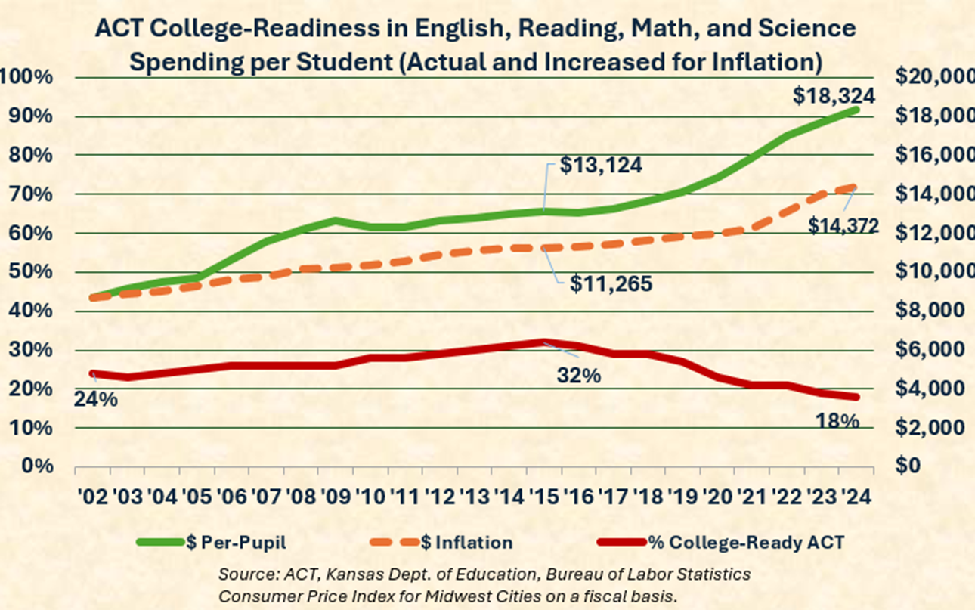
Lesson 1: Declining college readiness

Slide 22
Lesson 1: Declining college readiness
Caution: States with low participation have higher outcomes; Arizona’s 2021 spike coincided with a drop in participation

Slide 23
Lesson 2: District’s purpose is to improve student outcomes
“School systems do not exist to have great buildings, have happy parents, have balanced budgets, have satisfied teachers, provide student lunches, provide employment in the county/city, or anything else. Those are all means—and incredibly important and valuable means—but none of them are the ends. They are all inputs, not outcomes. None of those are measures of what students know or are able to do.” AJ Crabill, Great on Their Behalf

Slide 24

Lesson 2: Ineffective mission statements

Slide 25
Lesson 2: Easy test to determine purpose
Most district officials and board members probably would say that improving outcomes is the purpose, but their actions indicate otherwise.
  How much time is devoted to analyzing student outcomes on board agendas?
  Propose a resolution declaring that improving student outcomes is the district’s purpose, and that nothing can take priority over or interfere with the purpose.

Slide 26
Lesson 2: District’s purpose is to improve student outcomes
A candidate’s purpose for running should also be to improve student outcomes.
Board members deal with many issues, some of which are controversial.
Candidates running on improving outcomes are much harder to attack and criticize..

Slide 27
Lesson 2: Door-knocking script
Hi, I’m John Smith, and I’m running for the Sacramento School Board.
I want your thoughts on student achievement goals for the school district. Are you as frustrated as I am that only about a third of our students meet math and reading standards?
Pause

Slide 28
Lesson 2: Door-knocking script
I am running because I feel a duty to be part of the effort to help our education system better serve our most valuable resource, our students. We need school board members with the determination and leadership skills to guide the district through what is bound to be a difficult challenge.
What do you think our goal should be? Should we strive to have at least 65% of students proficient and ready to go on to college or skilled trades training? Or should the goal be higher or lower?

Slide 29
Lesson 2: Door-knocking script
Be prepared to say what you think should be done.
I won’t know until I have a chance to meet with teachers and principals…they are the experts. The board’s role is to set realistic improvement goals and ensure the district has a viable plan in place. Then we monitor progress and adjust as needed along the way.
Does that make sense to you?

Slide 30
Lesson 2: Discuss social issues through a student outcome lens
DEI premise – students will learn more if they feel welcomed.
Outcomes for Blacks and other minorities haven’t improved, so help me understand why we should divert time and resources to anything that isn’t producing the expected results.

Slide 31
Lesson 2: Student-focused or System-focused
Don’t use labels like Republican, conservative, or liberal.
Student-focused principles:
  Classroom budgets are built first.
  Curriculum and teaching methods are devoid of politics and social agendas, focusing solely on improving proficiency levels with proven instructional techniques.

Slide 32
Lesson 2: Setting the right tone is critical
Objections, concerns aren’t always stated. Get there first.
I believe teachers and everyone else have been working very hard to improve outcomes. Unfortunately, proficiency levels are far from where we all want them to be, and we need to figure out what changes are needed. We must all work together with the determination that no one is to blame, but everyone is responsible for implementing changes needed to get students the education they deserve.

Slide 33
Lesson 2: Setting the right tone is critical
Objections, concerns aren’t always stated. Get there first.
I believe teachers and everyone else have been working very hard to improve outcomes. Unfortunately, proficiency levels are far from where we all want them to be, and we need to figure out what changes are needed. We must all work together with the determination that no one is to blame, but everyone is responsible for implementing changes needed to get students the education they deserve.

Slide 34
Let’s talk
What challenges do you face discussing or learning about student outcomes, running for office, or anything else?
What else do you want to know?

