Slide 1
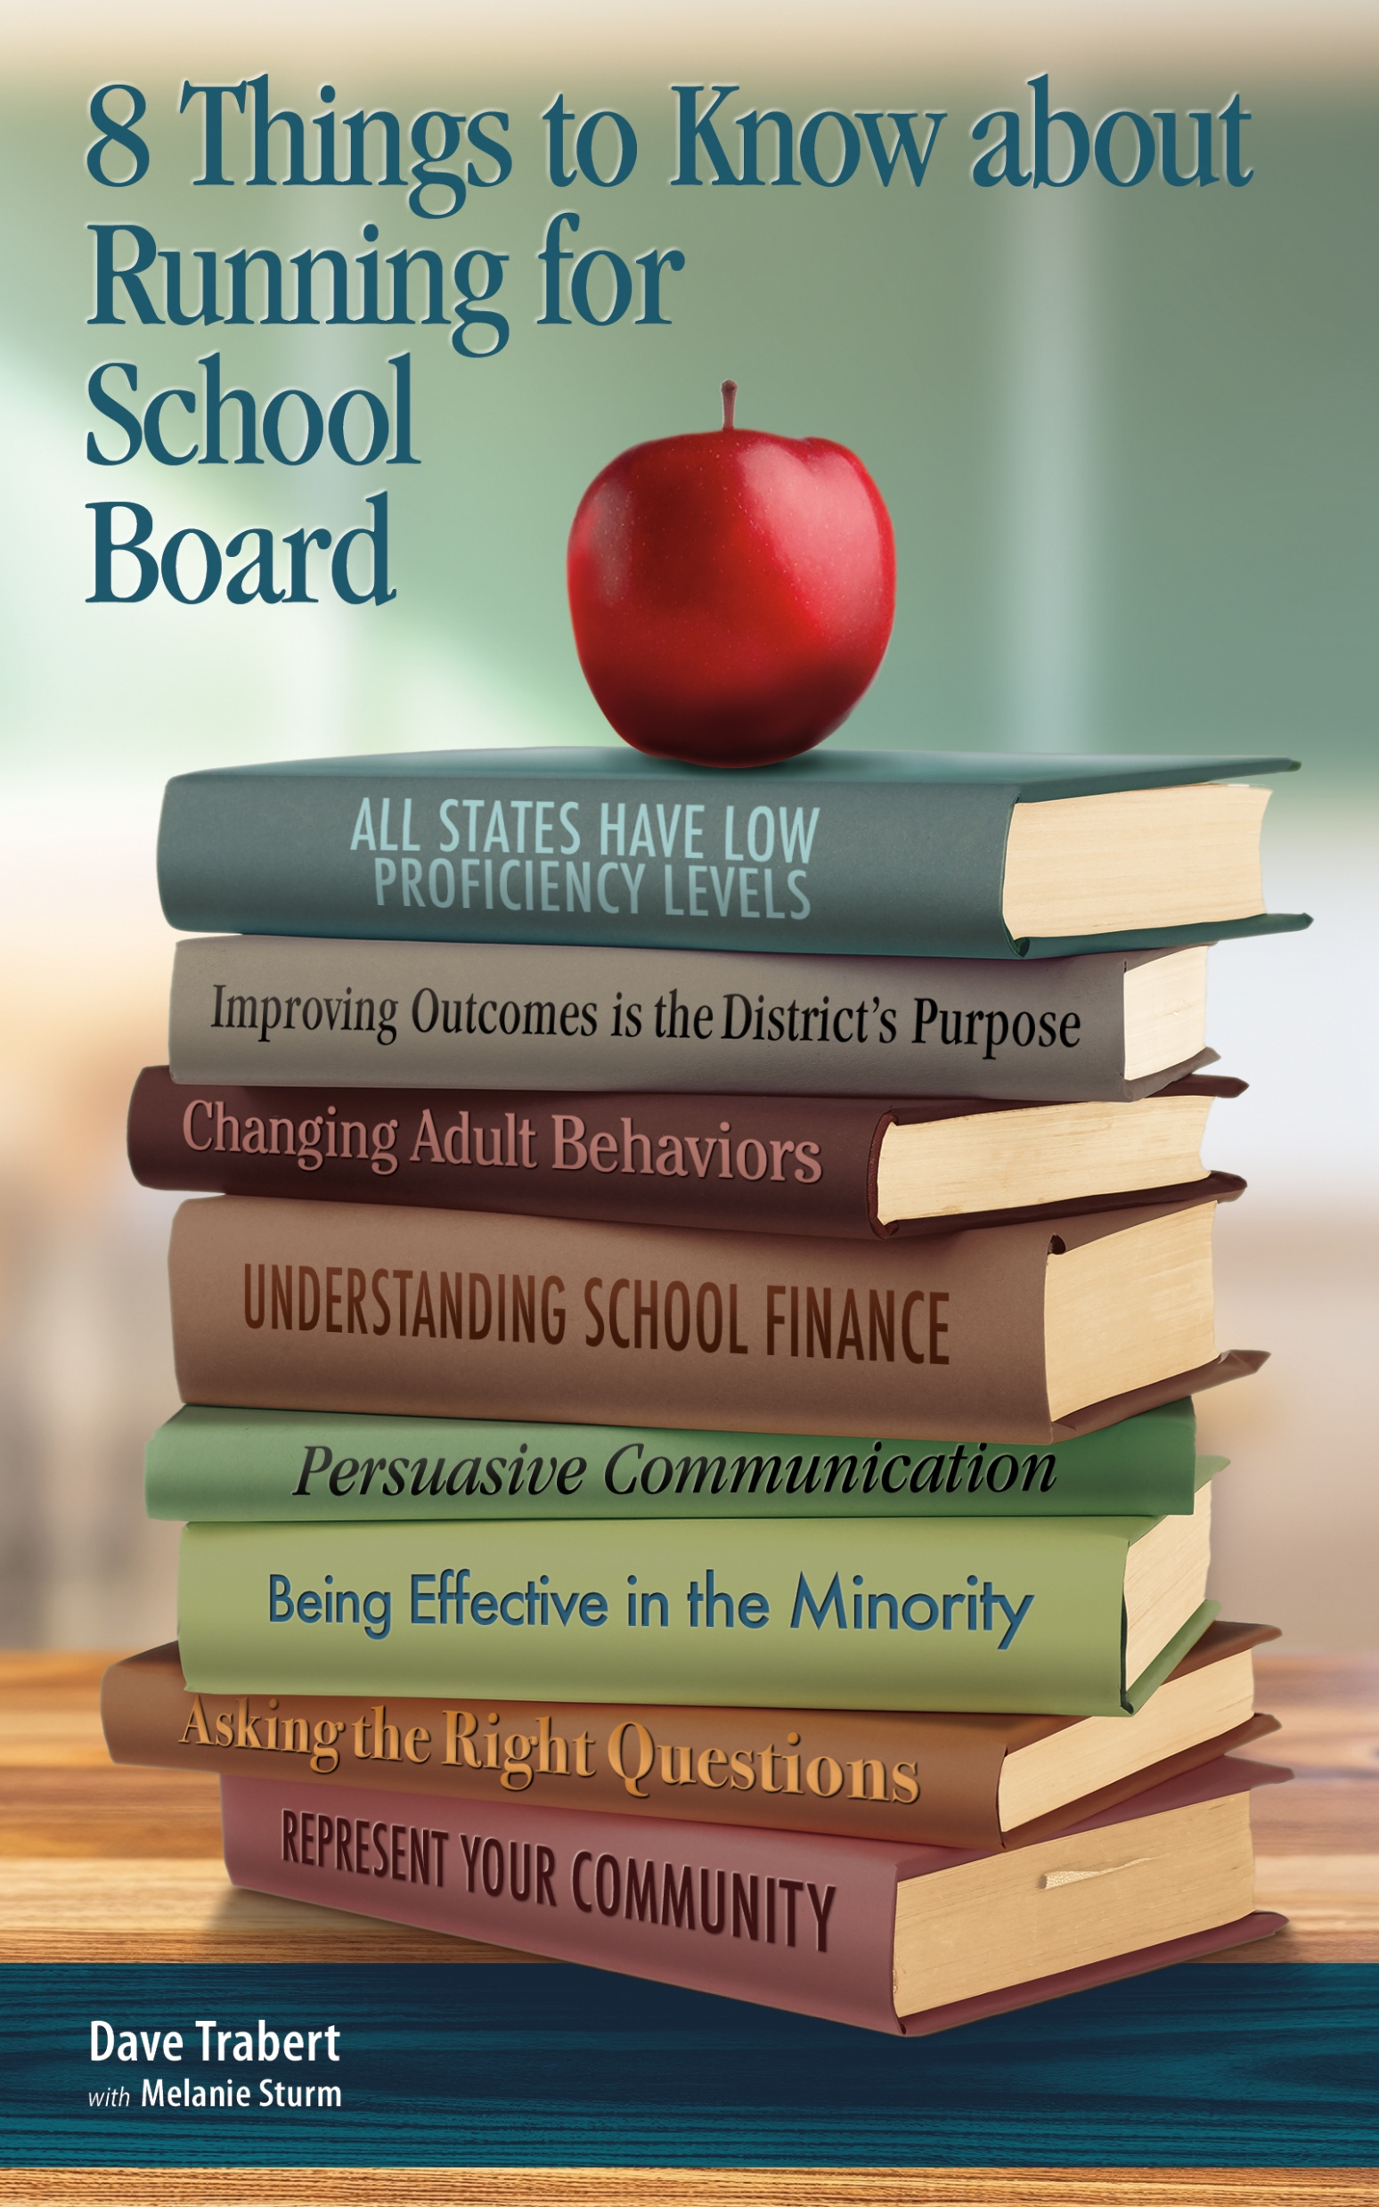
School Board Training Academy
Lessons 3 and 4
Dave Trabert
Kansas Policy Institute
Kansas School Board Resource Center

Slide 2
Lesson 3: Student outcomes won’t change until adult behaviors change
Jim Collins, Good to Great:
  First who, then what.
  Get the right people on the bus.
D11 Colorado Springs
  New board explained expectations
  Replaced the superintendent who wouldn’t go along.

Slide 3
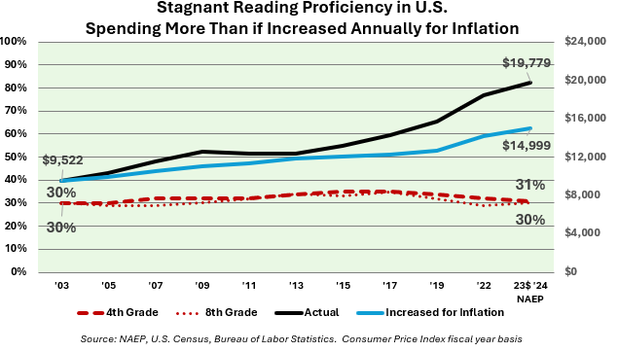
Lesson 3: Student outcomes won’t change until adult behaviors change

Slide 4
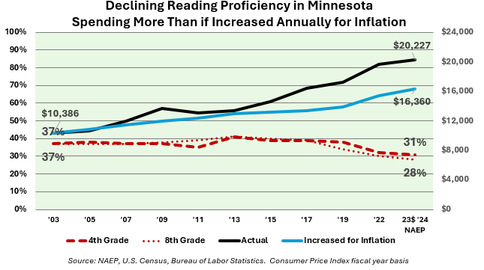
Lesson 3: Minnesota outcomes won’t change until adult behaviors change

Slide 5
Lesson 3: Kansas outcomes won’t change until adult behaviors change
Source: KSDE, NAEP, BLS

Slide 6
Lesson 3: KS Dept of Education
Allows school districts to violate the at-risk spending law.
Accreditation doesn’t require academic improvement as required in state law.
Says no students can be considered below grade level on the state assessment because “the test only measures grade-level performance.”
What action should the State School Board take?

Slide 7
Lesson 3: Drive change with needs assessment
Building needs assessment process creates leverage to drive change, reinforce the district’s purpose of improving student outcomes.
State law in Kansas is ignored, but a law isn’t needed for other states to implement.
Elementary school example

Slide 8
Lesson 3: Needs assessment meetings
Admin attend, but board members run the meetings. At least two board members attend.
Meet in school if possible for ease of mind.
Advance explanation of purpose
  Identify proficiency barriers
  Budgetary changes to overcome barriers
  No one to blame, everyone responsible

Slide 9
Lesson 3: Needs assessment meetings
Define barrier parameters:
  No generic barriers like ‘money’ or ‘staffing.’
  No political statements like ‘legislators don’t care.’
Be wary of topics schools cannot control:
  Early childhood needs.
  Mental health (is DEI making it worse?)
  Parental involvement

Slide 10
Lesson 3: Organize assessment meetings
One designated note taker.
Write barriers on poster paper
Separate symptoms from cause.
Get consensus on no more than the top three barriers.

Slide 11
Lesson 3: Identify budgetary changes
ID specific changes, e.g., hire reading specialist.
Brainstorm resource allocation opportunities:
  Ask teachers what they think about district spending.
  Hard numbers not necessary at this point.
  Budget staff can put numbers to the ideas and questions with the most potential
  Ask finance staff for their suggestions.

Slide 12
Lesson 3: Post-meeting analysis
Gather input from the business office:
  What happens if we don’t spend this (dues, travel, etc.)?
  Reduce costs with outsourcing & cross-district service-sharing.
  Are we losing money on food service?
  Are we fully utilizing bulk purchasing options?
  Have we recently done a communications audit?

Slide 13
Lesson 3: Create a public record
Publish a report summarizing the findings for each school (required in Kansas).
Summarize the changes (what was added and what was cut back) in the budget.
Discuss the BNA summary at the board meeting and in discussions with parents & community.

Slide 14
Lesson 3: Build support before formal pitch
What do you think our student achievement goal should be? 65% proficient in reading and math? Or should it be higher?
(after some form of agreement) Unfortunately, only 35% are proficient now. That’s no one’s fault…teachers working hard…we must decide what changes are needed to hit the goal…I’d like your opinion on this idea.

Slide 15
Lesson 3: Build support before formal pitch
(relative to Kansas law) Kansas law says local school boards “shall conduct” annual needs assessments in every school. Our district hasn’t been doing that, and I know the state school board association believes the law doesn’t require board members to do that; KASB says we must only review a staff-prepared summary.
But here’s my question…

Slide 16
Lesson 3: Build support before formal pitch
What’s wrong with teachers being able to share their challenges and ideas directly with school board members?
Despite everyone working so hard for many years to improve outcomes, unfortunately, only about a quarter of high school students here in Winfield are proficient, while 40% have limited ability in reading and math, according to the state assessment.

Slide 17
Lesson 3: Build support before formal pitch
Shouldn’t we all be willing to have open discussions of the challenges and opportunities, and learn what we can do differently to have students academically prepared for life after high school?
Don’t criticize; be the adult in the room and allow others to walk away from previous stances (or be seen as an obstacle to progress).

Slide 18
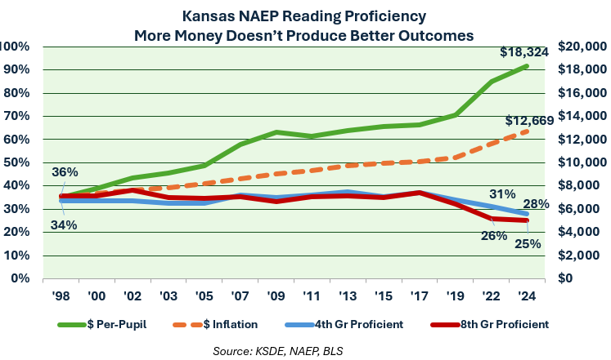
Lesson 4: Basics of school finance
Source: ACT, NAEP, Kansas Dept. of Education, Bureau of Labor Statistics Consumer Price Index for Midwest Cities on a fiscal basis.

Slide 19
Lesson 4: Money doesn’t drive outcomes

Slide 20
Lesson 4: Money doesn’t drive outcomes

Slide 21
Lesson 4: Money doesn’t drive outcomes
8-score NAEP composite of 4th grade and 8th grade reading and math for low-income students and those who are not low-income, equally weighted. MERIC Cost of Living Index for 2024.
Source: ACT, NAEP, Kansas Dept. of Education, Bureau of Labor Statistics Consumer Price Index for Midwest Cities on a fiscal basis.

Slide 22
Lesson 4: Cash/fund accounting
Districts have dozens of funds that operate like personal checkbooks.
Some funds have no restrictions, others have varying degrees of restrictions.
Ask the district CPA to present; staff are often misinformed.

Slide 23
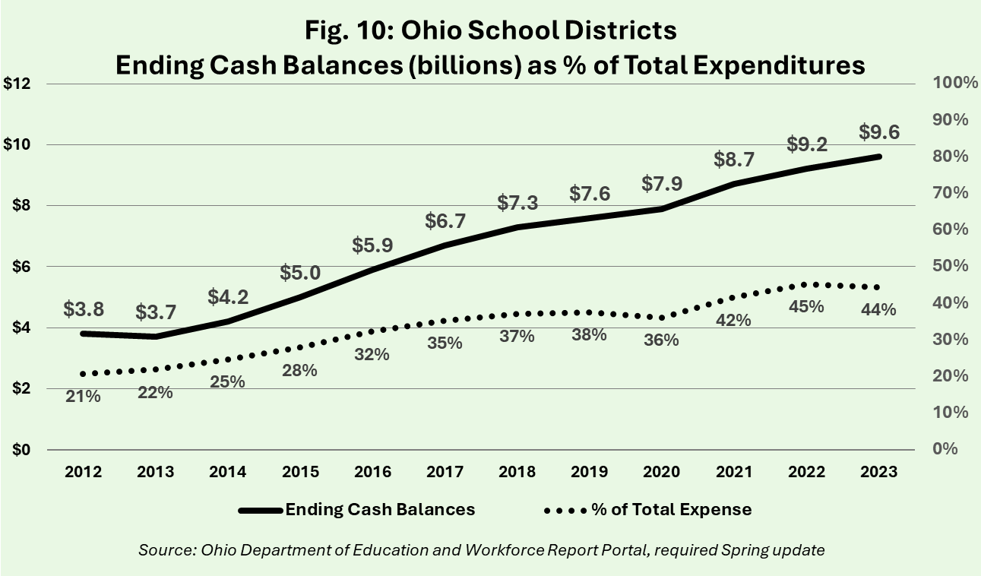
Lesson 4: Taxes not used for education

Slide 24
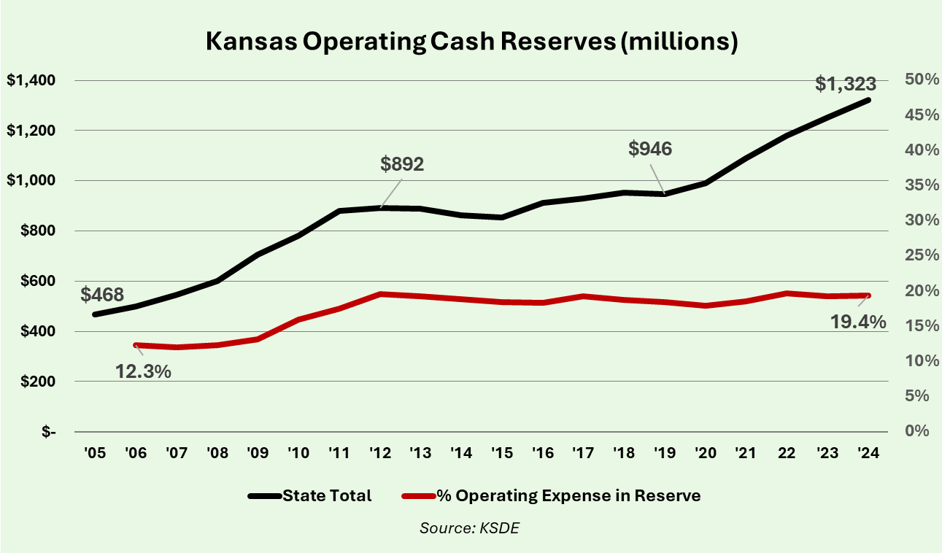
Lesson 4: Unspent taxes go to reserves
Operating Expense and Cash Reserves exclude Federal and KPERS pension funding

Slide 25
Lesson 4: Cash reserve myths & tips
A reserve balance in a fund isn’t necessary to pay expenses in that fund, per KSDE. Nine districts had zero Special Education reserves at the start of the last school year, and another 31 had less than 10% in reserve.
Dozens of districts have less than 12% in reserve each year.
Adjust transfers to restricted funds to spend balances down.

Slide 26
Lesson 4: Cash reserve myths & tips
Source: ACT, NAEP, Kansas Dept. of Education, Bureau of Labor Statistics Consumer Price Index for Midwest Cities on a fiscal basis.

Slide 27
Lesson 4: Special Education funding
Kansas Supreme Court accepted Legislature school funding proposal, including SPED:
  One-time $44 million increase
  $7.5 million annually thereafter
Legislative action
  Funding promise kept
  Failed to remove 92% statute

Slide 28
Lesson 4: Special Education funding
Statutory formula doesn’t count all state aid related to special education:
  LOB included for the regular education costs of SPED kids.
  LOB collected because of state SPED aid is inadvertently not counted.
  KSDE admits it may be an oversight.
  Legislators are afraid to fix the formula.

Slide 29
Lesson 4: Special Education funding
KansasOpenGov.org

Slide 30
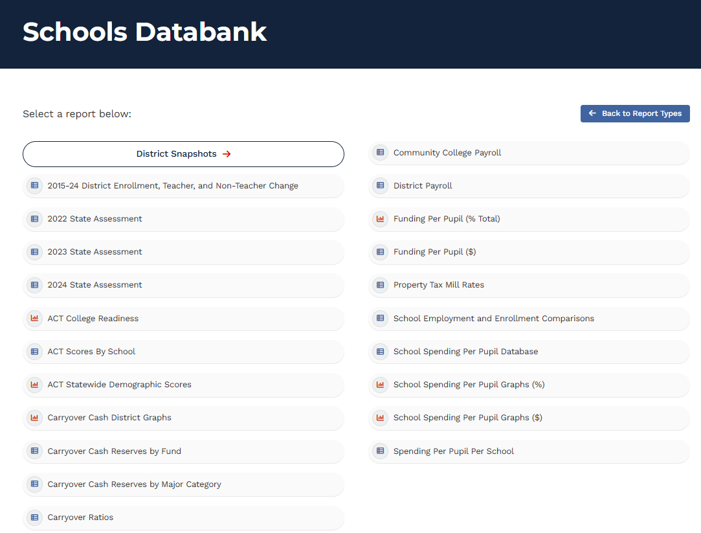
KansasOpenGov.org

Slide 31
Lesson 4: Employment benchmarking
Personnel accounts for about 80% of school spending.
Source: ACT, NAEP, Kansas Dept. of Education, Bureau of Labor Statistics Consumer Price Index for Midwest Cities on a fiscal basis.

Slide 32
Lesson 4: Cross-district benchmarking
At 215 students per manager, SMSD would has 35 fewer managers; 94 fewer in BV.
At $150k per manager, SMSD saves $5M and BV saves $14M.
Source: ACT, NAEP, Kansas Dept. of Education, Bureau of Labor Statistics Consumer Price Index for Midwest Cities on a fiscal basis.

Slide 33
Lesson 4: Per-Student spending change
Inflation was 55%
Source: ACT, NAEP, Kansas Dept. of Education, Bureau of Labor Statistics Consumer Price Index for Midwest Cities on a fiscal basis.

Slide 34
Lesson 4: Per-Student spending change
Source: ACT, NAEP, Kansas Dept. of Education, Bureau of Labor Statistics Consumer Price Index for Midwest Cities on a fiscal basis.

Slide 35
Lesson 4: Per-Student state aid components (state avg., approx.)
2023 Actual
2024 Actual
BASE + weightings* $ 8,334 $8,750
Capital equalization** 188 217
Bond equalization** 423 452
Special education 1,125 1,236
KPERS pension 1,133 1,143
  Total $11,202 $11,797
  *the only portion distributed on a per-pupil basis
  **for districts qualifying as property-poor

Slide 36
Lesson 4: Inflation-adjusted does not determine if spending kept up with inflation
2024 spending has less purchasing power than in 2021, but the inflation-adjusted methodology doesn’t account for additional buying power added over time.

Slide 37
Lesson 4: Increase spending each year for inflation and compare to actual
Spending declined during the Great Recession, but it was still more than if spending had increased yearly for inflation since 2005.

Slide 38
Let’s talk
Is your district student-focused or system-focused?
School finance questions?
What else do you want to know?

