Slide 1

KSDE & State Board of Ed Reduced Proficiency Standards to make outcomes look better …and this isn’t the first time

Slide 2
Bogus rationale for reducing standards
After years of bragging about having high standards equating to Proficient on NAEP, they now say the NAEP standard is too high.
NAEP Proficient: “represents solid academic performance for each grade assessed…demonstrated competency over challenging subject matter.”
NAEP Basic: “denotes partial mastery of the knowledge and skills.”

Slide 3
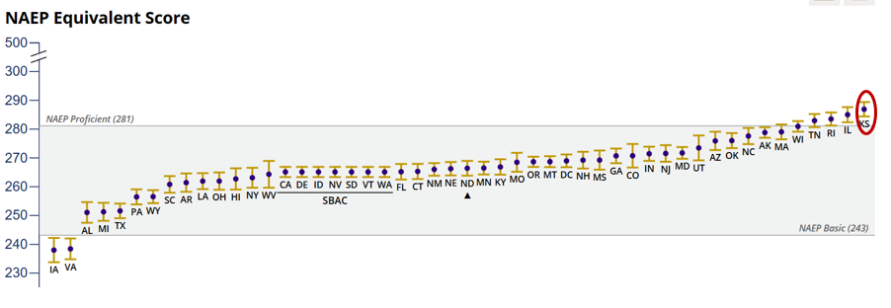
NAEP 2022 mapping study: 8th Grade Reading
Lower standard will likely equate to NAEP Basic

Slide 4
Proficiency jumps when KSDE reduces standards
Notes:
The National Assessment of Educational Progress (NAEP) consistently showed about a third of 8th graders proficient in reading from 1998 through 2017, then dropping to about 25%. The NAEP test, also known as The Nation’s Report Card, is the gold standard of measuring proficiency in reading and math.

Slide 5
Proficiency jumps when KSDE reduces standards
Notes:
State assessments showed very similar results in 2000 and 2001.

Slide 6
Proficiency jumps when KSDE reduces standards
Notes:
Then Kansas reduced proficiency standards as part of No Child Left Behind in 2002 and proficiency artificially jumped from 34% to 65% overnight. The increase wasn’t real, of course. The kansas department of education reduced the proficiency standard. It’s like having 90 to 100 qualifying for an A, then changing the standard for an A to 70-100.

Slide 7
Proficiency jumps when KSDE reduces standards
Notes:
The US Dept of Education said Kansas had low proficiency standards for many years, which is why state assessment results were so much higher than on the Nation’s Report Card.

Slide 8
Proficiency jumps when KSDE reduces standards
Notes:
The state school board went back to having high proficiency standards in 2015, and proficiency fell to 30%, and about the same as NAEP. The state assessment and NAEP showed very similar results from 2015 through 2024.

Slide 9
Proficiency jumps when KSDE reduces standards
Notes:
This year, the state school board reduced the proficiency standard again, and proficiency more than doubled, going from 22% to 46%. They say they didn’t reduce rigor, but that’s just not believable.

Slide 10
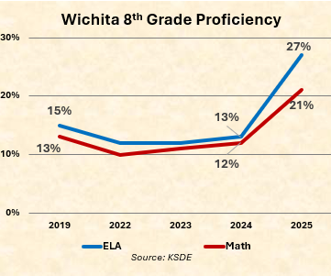
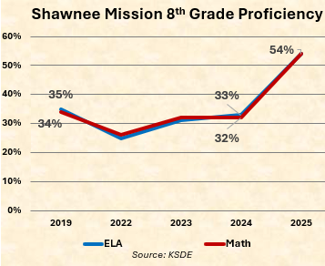
District results are artificially inflated

Slide 11
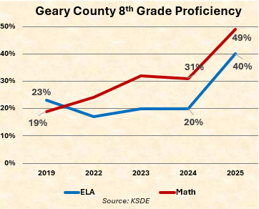
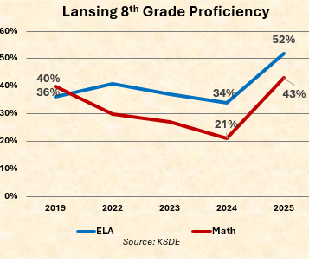
District results are artificially inflated

Slide 12
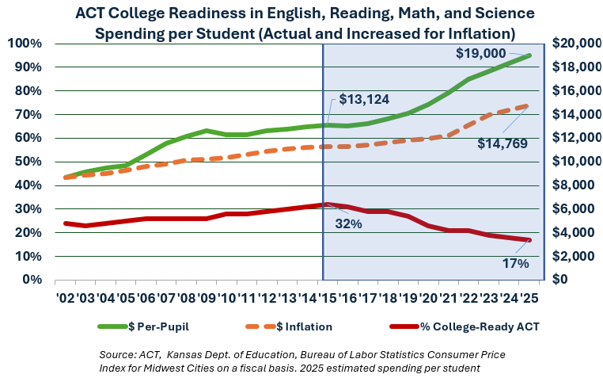
Like NAEP, ACT also shows declines

Slide 13
Legislators can override KSDE
Low, ever-changing standards prevent school boards from tracking student progress.
Oklahoma lowered the bar in 2024 but has since reversed course.
If you want to return to high standards and be able to track progress…Legislators need to hear from you.

