Slide 1
GOVERN
DIFFERENTLY
Values-Based Governance for School Boards
Aaron Salt
Founder, ChalkForge
Exec VP, SBAE

Slide 2
"I've been booed, cheered, and
haggled by Satanists
and religious zealots."
But, more importantly, I've been effective.
A decade of experience on school boards across Colorado

Slide 3
THE TOXIC CYCLE
Board focuses on
social issues over education
Community backlash
at the ballot box
◄
▼
▲
Students and academics
get left behind — again
New board focuses on
opposite social issues
◄
Does this feel familiar?

Slide 4
THE FOUR DYSFUNCTIONS
Know anyone?
ACTIVE
The Stair-Stepper
The Crusader
Uses the board seat as a stepping stone. Ego and ambition over students.
Champions pet causes and grandstands. Minor issues become months-long campaigns.
PASSIVE
The Hands-on Hero
The Appeaser
Crosses into management. Focuses on the how instead of the why.
Avoids conflict at all costs. Rubber-stamps decisions to survive another day.
These dysfunctions make it nearly impossible to focus on mission and student outcomes.

Slide 5




WHEN GOVERNANCE WORKS
Districts that implement strong governance frameworks see:
Improved Student
Achievement
Higher Staff Retention
& Morale
Increased Community
Trust & Support
More Effective Use of
Taxpayer Resources

Slide 6
SECTION 1
Building the
Foundation
Shared language before shared framework

Slide 7


WHAT GOVERNANCE ACTUALLY IS
AUTHORITY
POWER
Granted by law & community
Bounded & defined
Focused on service
Exercised through policy
Self-assumed or taken
Unbound & expansive
Focused on self
Exercised through control
Governance isn't about being important. It's about being effective in the service of students.

Slide 8

THE OUTSIDER PROBLEM
Every new board member is an outsider.
Nobody in the administration knows who you are, what you believe, or how you approach things.
Too often, new members try to prove how smart they are. But no one cares what you have to say until you've earned the right to speak to the organization.
This is done through relationship building.

Slide 9

VALUES VS. PRINCIPLES
VALUES
PRINCIPLES
The deep "WHY"
behind decisions
The operational "HOW"
that flows from values
From Latin valere —
strength, worth
Actionable rules built
from shared values
VBG asks boards to identify shared values for student outcomes — not impose personal ones.

Slide 10
FIVE VALUE SETS TO NAVIGATE
As a board member, you're constantly balancing competing value systems:
Your Values
Your personal paradigm — tightly held, core to who you are
Board Values
Where your values overlap with fellow members — shared ground
District Values
Amalgamation of views built over decades — drives daily operations
Societal Values
National undercurrents — can linger in policy long after they shift
Group Values
Activist groups, chambers, neighborhoods — often expect you to champion theirs
The challenge: stay true to your values while considering the others. VBG helps you navigate this.

Slide 11
QUICK SELF-CHECK
Be honest with yourself:
1
Can every board member recite your district's mission from memory?
2
What percentage of your board agenda items directly relate to academics?
3
When did your board last change its mind based on student outcome data?
4
Would your superintendent describe the board as supportive partners — or obstacles?
If these are hard to answer, that's exactly why VBG matters.

Slide 12
SECTION 2
The VBG
Framework
Three tenets. One mission: student outcomes.

Slide 13


VALUES-BASED GOVERNANCE
An approach to leading and stewarding an organization where decisions and actions are guided by a set of core values, aligning personal, organizational, and stakeholder principles for ethical and effective management.
Strategic
Alignment
Policy
Development
Cultural
Adaptation
Operations match
mission & vision
Values encoded
in governance
Values internalized
across the district

Slide 14


TENET 1: STRATEGIC ALIGNMENT
Operations and day-to-day actions align with your mission, vision, and core values.
When aligned, districts see:
Reduced operating costs through focused priorities
Increased staff morale from clear direction
Increased stakeholder support from transparent decision making

Slide 15
THE FOUNDATIONAL DOCUMENTS
Every decision should filter through these foundational elements:
Mission
Vision
Unique Value Proposition
Shared Values
Governing Policies

Slide 16
THE DECISION LENS
Every decision should filter through these foundational elements:
Mission
Vision
Unique Value Proposition
Shared Values
Governing Policies
▼
ALIGNED DECISIONS

Slide 17
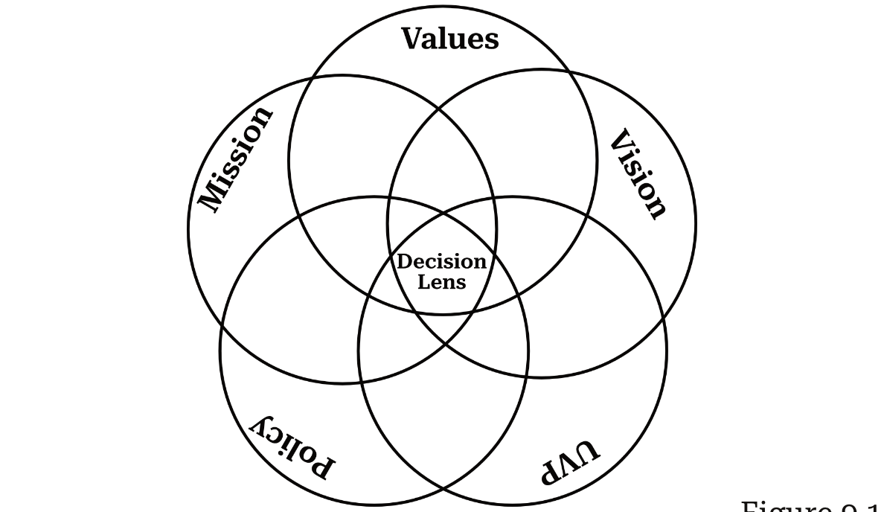
THE DECISION LENS
Every decision should filter through these foundational elements:

Slide 18
TENET 2: POLICY DEVELOPMENT
GOVERNING
POLICY
OPERATIONAL
POLICY
Where the board inputs values
Where admin carries values forward
Sets direction & expectations
Framed as positive value statements
Reflects mission & shared values
Must align with governing policy
Managed by superintendent
Constantly in flux (law, practice)
Operational policy must align with governing policy. This is where accountability begins.

Slide 19
THE USER STORY
Developing policy should have a specific condition in mind
Story time…

Slide 20
THE USER STORY
Developing policy should have a specific condition in mind
As a (who) ,
I would like (what) ,
So that (why) .

Slide 21
THE USER STORY
Developing policy should have a specific condition in mind
As a parent of an elementary student,
I would like increased communication about upcoming events,
So that I don’t miss my kids recital.

Slide 22

TENET 3: CULTURAL ADAPTATION
Culture doesn't change because you pass a policy. It changes when people internalize the values behind it.
This is the long game — and where most boards fail.
Model the behavior you expect — the board sets the example
Test it in the buildings: ask staff about mission, vision, and UVP
Build self-accountability before demanding it from others
Accountability takes time to bake into every level of the district

Slide 23
ACCOUNTABILITY
GOAL SETTING
SMART Goals
Framed in the positive
Focused on academics/students
Top-down approach
Transparent hits/misses
Threshold for critical misses
Operational policy must align with governing policy. This is where accountability begins.

Slide 24
HOW IT ALL FITS TOGETHER
Strategic
Alignment
Policy
Development
Cultural
Adaptation
Sets direction
Encodes values
Makes it stick
They're not sequential steps — they reinforce each other continuously.

Slide 25
HOW IT ALL FITS TOGETHER
Strategic
Alignment
Policy
Development
Cultural
Adaptation
Defines values
Embeds values
Implements values
These tenets reinforce each other continuously.

Slide 26
MISCONCEPTIONS ABOUT VBG
"It's about imposing personal values"
It focuses on shared values for student outcomes — not any individual's agenda.
"It's a partisan framework"
It transcends politics. I've served successfully with people across the entire spectrum.
"It requires unanimous agreement"
A single board member can adopt VBG and start seeing benefits individually.

Slide 27
SECTION 3
What You Can
Do Tomorrow
Practical actions to begin shifting your board and district

Slide 28

FIRST THINGS FIRST
The first step isn't policy reform.
It's relationship building. You must earn the right and permission to speak to the organization before your values or ideas mean anything.
It's not about changing what the district does —
it's about how the district accomplishes its mission.

Slide 29
THE 91-DAY ROADMAP
DAY 1
Communicate VBG intent to community
DAY 7
Review Mission, Vision & UVP
DAY 14
Build the Decision Lens
DAY 28
Develop shared board values
DAY 35
Set superintendent goals
DAY 49
Align superintendent evaluation
DAY 63
Update governing policies
DAY 91
Operational policy review underway
Full 91-Day Implementation Guide available at ChalkForge.com

Slide 30
DO THIS NEXT WEEK
THE MISSION TEST
1
If the answer is no, that's where you start.
Gather your mission, vision, and unique value proposition. Do they still reflect what your district is trying to accomplish?
If your foundational documents are unclear, everything built on top of them will be too.
MONDAY
Can every board
member recite your
district's mission?

Slide 31
DO THIS NEXT WEEK
THE AGENDA AUDIT
2
Pull your last three meeting agendas.
How many items directly connected to student outcomes and academic achievement?
This is a simple diagnostic that reveals where your board's attention is actually going.
What % of your
agenda items relate
to academics?

Slide 32
DO THIS NEXT WEEK
THE ACCOUNTABILITY QUESTION
3
If you're asking "how do we evaluate?" mid-year, you're already behind.
Set clear goals upfront. Align evaluations to those goals. Use the proper yardstick to measure outcomes.
Accountability starts with clear expectations.
Are your superintendent's
goals set before
the year starts?

Slide 33

YOU DON'T NEED PERMISSION
VBG doesn't require the whole board to buy in at once.
A single member can adopt it and start seeing benefits. VBG is an individual framework that scales — you can implement it on your own and it doesn't require shifts in your district's policy book.
This removes the "but my board won't go for it" objection entirely.

Slide 34

KEY TAKEAWAYS
Three Tenets
Strategic Alignment, Policy Development, Cultural Adaptation
The Decision Lens
Filter every decision through mission, vision, values, and policy
Three Monday Actions
Mission test, agenda audit, accountability check
Start Individually
You don't need the whole board to begin — start with yourself

Slide 35


YOUR RESOURCES
Screenshot this slide!
THE BOOK
FREE TOOLS
Govern Differently
91-Day Implementation Guide
Board Self-Assessment
Shared Values Exercise
Superintendent Evaluation Template
Superintendent Goal Template
User Story Template
New Board Member Survival Kit
An Academic-Focused Governance Model
and How to Use It for Good
By Aaron Salt
ChalkForge.com

Slide 36


WHAT'S IN THE BOOK: PART IV
Practical tools to turn the framework into action
Ch 13
Implementation Timeline
The 91-Day Plan — a step-by-step roadmap from Day 1 to operational policy review
Ch 14
Assessment & Planning Tools
Board self-assessment, shared values exercise, user story templates, and the 4A Framework
Ch 15
New Board Member Survival Kit
Everything a new member needs to hit the ground running with VBG from day one
Ch 16
Troubleshooting Guide
How to handle resistance, dysfunctional colleagues, unresponsive administration, and more
All of these resources are included in Govern Differently and available at ChalkForge.com

Slide 37

QUESTIONS?
Aaron Salt
@aaronsalt | aaron@sbaenetwork.org | 719.445.9202

